Slide 1

Go Here. Get There.

Slide 2
Active Shooter Presentation
PSC Police Department

Slide 3
INTRODUCTION
The purpose of this presentation is to encourage proactive thinking and awareness about events that could unfold in an active shooter situation on campus. If such an event happens, you and the people around you will have to quickly make many decisions about what actions to take for your own safety in response to the threat.

Slide 4
BACKGROUND ON ACTIVE SHOOTER INCIDENTS
The FBI defines an Active Shooter incident as “one or more individuals actively engaged in killing or attempting to kill people in a confined and populated space.”

Slide 5
BACKGROUND ON ACTIVE SHOOTER INCIDENTS
According to the FBI, in 2018 there were:
27 Active Shooter incidents in 16 states, resulting in
85 killed
128 wounded

Slide 6
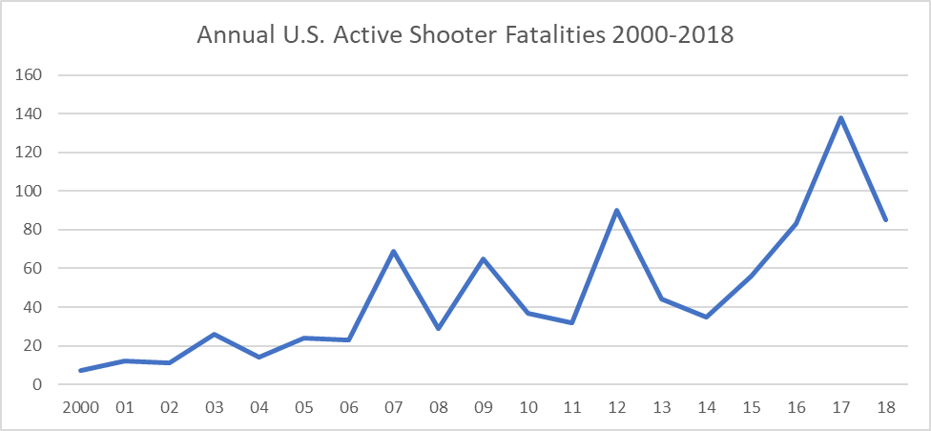
BACKGROUND ON ACTIVE SHOOTER INCIDENTS
However, the number of fatalities fluctuates from year to year, and the trend is generally increasing from 7 in 2000 to a high of 138 in 2017.

Slide 7
KEEPING THINGS IN PERSPECTIVE
The Risk is Very Serious, but the Probability of an Incident is Low.
ANNUAL U.S. DEATHS SOURCE:
Drug Overdoses 70,237 (2017) The Centers for Disease Control and Prevention
Traffic Accidents 37,133 (2017) The National Highway Traffic Safety Administration
Airplane Crashes 393 (2018) The National Transportation Safety Board
Active Shooters 85 (2018) The U.S. Department of Justice
Lightning Strikes 27 (Average 2008-2018) The National Weather Service

Slide 8
Preparation for an active shooter incident is everyone’s responsibility. According to the U.S. Department of Homeland Security
“Active shooter situations are unpredictable and evolve quickly… Because active shooter situations are often over within 10 to 15 minutes -- before law enforcement arrives on the scene -- individuals must be prepared both mentally and physically to deal with an active shooter situation.”

Slide 9
Your Mental Preparation is Important!
You will have to THINK FOR YOURSELF when an incident happens because our mass notification system can tell you WHAT IS HAPPENING, but it cannot tell you WHAT TO DO.
You must be prepared to ACT ON YOUR OWN because it is not possible to have police officers everywhere at all times, and many incidents are over before law enforcement arrives.

Slide 10
Active Shooter Video
See PSC website at
www.pensacolastate.edu/publicsafety
and select the “Active Shooter Training” tab.

Slide 11
PLAN – Have a plan for your surroundings
EVALUATE – Determine the best response
RESPOND – Take action
RUN – Flee the area if possible
HIDE – Shelter in Place
FIGHT – Put up a defense if necessary

Slide 12
IF YOU RUN – If there is an accessible escape path, attempt to evacuate the premises. Be sure to:
Have an escape route and plan in mind
Evacuate regardless of whether others agree to follow
Leave your belongings behind
Help others escape, if possible
Prevent others from entering the area
Follow the instructions of any police officers
Do not attempt to move wounded people
Call 911 when you are safe

Slide 13
IF YOU HIDE – If evacuation is not possible, find a place to hide where the active shooter is less likely to find you.
Your hiding place should:
Be out of the active shooter’s view
Provide protection if shots are fired in your direction (i.e., an office with a closed and locked door)
Not trap you or restrict your options for movement (if possible)
To prevent an active shooter from entering your hiding place:
Lock the door
Blockade the door with heavy furniture

Slide 14
HOW TO RESPOND WHEN AN ACTIVE SHOOTER IS IN YOUR VICINITY
If the active shooter is nearby:
Lock the door
Silence your cell phone
Turn off any source of noise (i.e., radios, televisions)
Hide behind large items (i.e., cabinets, desks)
Remain quiet

Slide 15
IF YOU FIGHT – As a last resort, and only when your life is in imminent danger, attempt to disrupt and/or incapacitate the active shooter by:
Acting as aggressively as possible against the attacker.
Throwing items and improvising weapons such as chairs, books, paperweights, fire extinguishers or other heavy items.
Using numbers to overwhelm the attacker. There is strength in working together.
Yelling to startle the attacker and draw attention to the situation.
Committing to your actions and fighting like your life depends on it.

Slide 16
ACTIONS OF DEPARTMENT HEADS AND SUPERVISORS DURING AN ACTIVE SHOOTER SITUATION
Employees and students are likely to follow the lead of department heads and supervisors during an emergency situation. During an emergency, department heads and supervisors should be familiar with the physical facilities in their assigned areas of authority and be prepared to:
Remain calm and take immediate action.
If sheltering in place is the best action in your area, direct the locking and barricading of internal and external doors. If you are unsure how to lock external doors, schedule a meeting with Public Safety to learn the procedure.
If evacuating is the best action in your area, direct the evacuation of students and employees via the safest possible route.

Slide 17
EVALUATING THE BEST RESPONSE: RUN, HIDE OR FIGHT?
External factors determine the most appropriate option to be exercised in a shooter situation. Factors include:
Your proximity in relationship to the shooter
Your proximity to a secure path that will lead you to a secure location
Your proximity to predetermined secure and safe areas
The type of weapon being utilized in the attack

Slide 18
EVALUATING THE BEST RESPONSE: RUN, HIDE OR FIGHT?
Running is an option if:
You have a secured path to a safe place, AND
You can stay out of the attacker’s line of sight and fire.
Hiding may be your best option if:
A secure path or an exit is not a certainty, OR
There is no safe place to go once outside.

Slide 19
YOU MAY HAVE TO ADJUST YOUR PLAN
AS EVENTS UNFOLD
You may HIDE in a secure place while waiting for the opportunity to RUN.
You may RUN until you find a more secure location to HIDE.
RUN, HIDE, FIGHT are not steps, but options that may be exercised in any order. Again, the selection of the options to be exercised will be dictated by the circumstances or external factors that you must evaluate.

Slide 20
OTHER THINGS TO CONSIDER:
Initial reports may be wrong. Police will rely on initial information received from 911 calls to determine the location of the shooter. The sound of gunshots may echo and seem to come from different directions, causing callers to be mistaken. We will make every effort to give correct information, but at the outset we will only know what has been reported. As updates come in, we will send further PSC Alerts to update everyone.

Slide 21
REPORTING AN INCIDENT
If you witness an incident, as soon as you get to safety CALL 911 FIRST. Then, if you are able, call the PSC Police Department second at 484-2500.
Why call 911 first? In the event of an incident, there will likely be more calls than the PSC dispatch can handle at once. Local 911 call centers have the capacity for hundreds of calls and they can summon campus police.
Do not call the PSC police department to ask questions about what is going on. All police personnel will be engaged in responding to the threat. Updates will be given via PSC Alerts, so please be patient, stay safe, and await updates.

Slide 22
REPORTING AN INCIDENT
When you call 911, give as many details as you can, including:
Location of the active shooter
Number of shooters, if more than one
Physical description of shooter’s features, such as hair color, gender, size, ethnicity, distinguishing marks, etc.
Description of the shooter’s clothing, such as shirt, pants, jacket, etc.
Number and type of weapons held by the shooter, if known
Number of potential victims at the location

Slide 23
ALTHOUGH YOU MUST ACT ON YOUR OWN,
YOU ARE NOT ALONE.
When a call is received by PSC Police or 911 Operator:
Armed PSC Police Officers are Dispatched to the Scene
Surrounding Local Law Enforcement is Dispatched to the Scene
Emergency Medical Assistance is Dispatched to the Scene
Unarmed PSC Public Safety Officers Set Up a Perimeter and Direct People Away From Danger
PSC Police Officers have radios that connect directly with local law enforcement

Slide 24
POLICE RESPONSE
The first priority of police officers will be to locate and stop the shooter.
Police officers arriving on the scene will not be directing evacuations.
Officers will not be providing medical assistance to the wounded. Until the shooter has been stopped, the shooter will be their primary focus.
Do not follow police officers thinking they will lead you to safety. Officers will be going toward the threat.

Slide 25
HOW TO REACT WHEN LAW ENFORCEMENT ARRIVES:
Remain calm, and follow officers’ instructions
Put down any items in your hands (i.e., bags, jackets)
Immediately raise hands and spread fingers
Keep hands visible at all times
Avoid making quick movements toward officers such as holding on to them for safety
Avoid pointing, screaming and/or yelling
Do not stop to ask officers for help or directions when evacuating, just proceed in the direction from which officers are entering the premises

Slide 26
SIGN UP FOR ADDITIONAL PSC ALERTS AT: https://www.pensacolastate.edu/pscalert/
Every student and employee is automatically enrolled, but the initial enrollment only includes your PSC email address.
For added protection, log in to the system and provide your cell telephone number to receive text messages. You can also have messages delivered by telephone calls, voicemail and additional email addresses that you provide.
Kelly employees are not automatically enrolled in PSC Alerts, but there are sign-up instructions on the PSC Alert page.

Slide 27
PSC Police Department
Sean Fagan
Chief of Police
Shane Brannock
Assistant Chief
Sgt. Rodney Rani
Sgt. Rick Steele
Nick Churill
Blake Forehand
Amanda Gary
Monte Haight
David Hinds
Stephanie Mendez
Terry White

Slide 28
PLAN – Have a plan for your surroundings
EVALUATE – Determine the best response
RESPOND – Take action
RUN – Flee the area if possible
HIDE – Shelter in Place
FIGHT – Put up a defense if necessary

Slide 29
Proactive Measures for Safety
Pirates CARE Team

Slide 30
Individuals typically do not just “snap,” but display indicators of potentially violent behavior over time. If these behaviors are recognized and reported, they can often be managed and treated.

Slide 31
EARLY DETECTION OF THREATS
Source: The Safe School Initiative Report Prepared by
the U.S. Secret Service and U.S. Department of Education
Characteristics of School Shooting Incidents:
Incidents of targeted violence at school are rarely sudden, impulsive acts.
Prior to most incidents, other people knew about the attacker’s idea and/or plan to attack.

Slide 32
Most attackers did not threaten their targets directly prior to advancing the attack.
There is no profile of a student attacker.
Most attackers engaged in some behavior, prior to the incident, that caused others concern or indicated a need for help.
Most attackers had difficulty coping with significant losses or personal failures.
Many attackers had considered or attempted suicide.

Slide 33
Many attackers felt bullied, persecuted, or injured by others prior to the attack.
Most attackers had access to and had used weapons prior to the attack.
In many cases, other students were involved in the attack in some capacity (in over half of the incidents others assisted in planning or execution of attack by actively encouraging the attacker to shoot others at school, helping select targets, and training a shooter how to use a weapon).

Slide 34
INDICATORS OF POTENTIAL VIOLENCE BY AN EMPLOYEE
Potentially violent behaviors by an employee may include one or more of the following (this list of behaviors is not comprehensive, nor is it intended as a mechanism for diagnosing violent tendencies):
Increased use of alcohol and/or illegal drugs
Unexplained increase in absenteeism; vague physical complaints

Slide 35
Noticeable decrease in attention to appearance and hygiene
Depression / withdrawal
Resistance and overreaction to changes in policy and procedures
Repeated violations of policies
Increased severe mood swings
Noticeably unstable, emotional responses
Explosive outbursts of anger or rage without provocation
Suicidal; comments about “putting things in order”

Slide 36
Behavior which is suspect of paranoia, (“everybody is against me”)
Increasingly talks of problems at home
Escalation of domestic problems into the workplace; talk of severe financial problems
Talk of previous incidents of violence
Empathy with individuals committing violence
Increase in unsolicited comments about firearms, other dangerous weapons and violent crimes

Slide 37
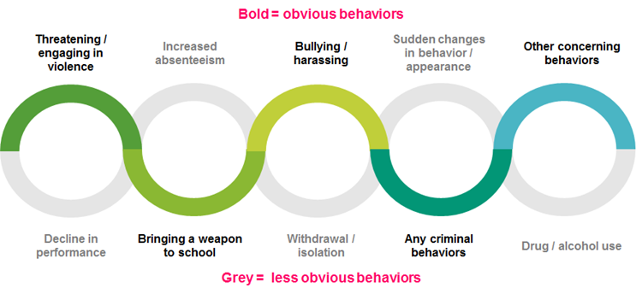
BEHAVIORS OF CONCERN
Individuals who engage in violent attacks often display concerning behaviors that progress along a continuum of increasing distress.

Slide 38
THRESHHOLD FOR BEHAVIORS OF CONCERN
Due to the progression of behavior prior to an incident, the threshold for intervention should be relatively low so that we can identify students or employees who are in distress before the behavior escalates to the point where college community members become concerned about their safety or the safety of others.

Slide 39
REPORTING BEHAVIORS OF CONCERN
Maxient software is a reporting tool found on the Pirates CARE web page for sharing concerns about the behavior or wellbeing of employees and students. Maxient is also used to report student conduct issues and student academic misconduct.
Employees and students who exhibit concerning behavior should be reported through the “Refer an Employee of Concern” tab or the “Refer a Student of Concern” tab on the Pirates CARE web page. When reports are submitted, they are automatically routed to the appropriate people to address the issues.

Slide 40
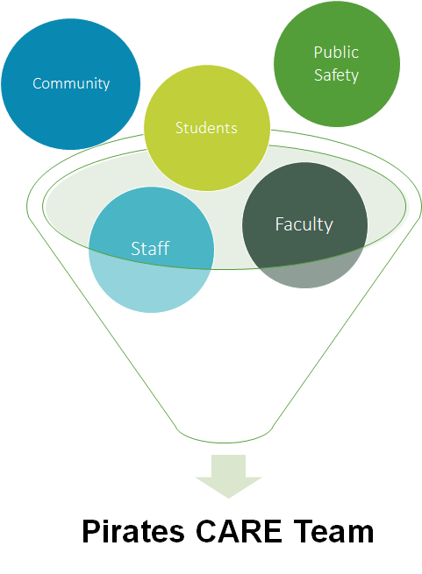
Pirates CARE Team Reports Come From Multiple Sources

Slide 41
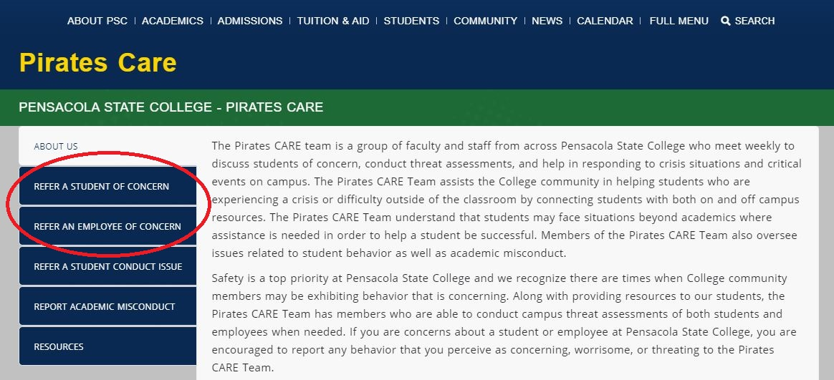
PensacolaState.edu/PiratesCare

Slide 42
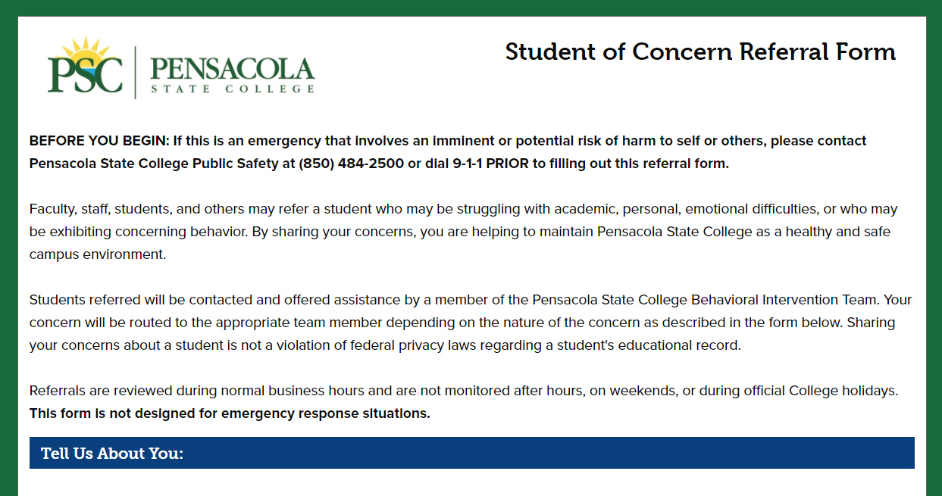
PensacolaState.edu/PiratesCare

Slide 43
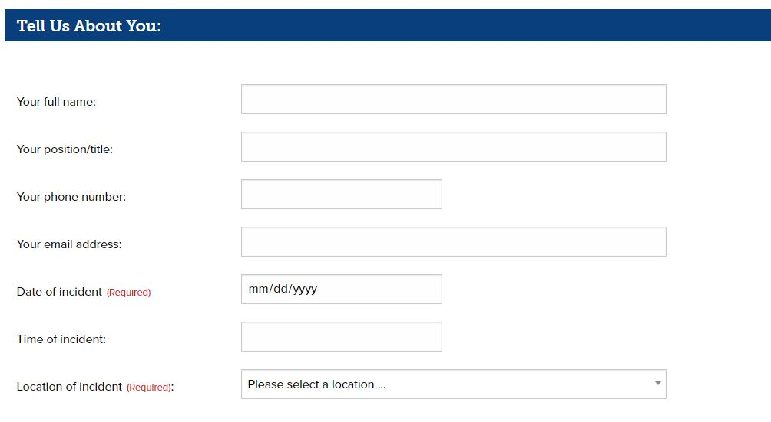
PensacolaState.edu/PiratesCare

Slide 44
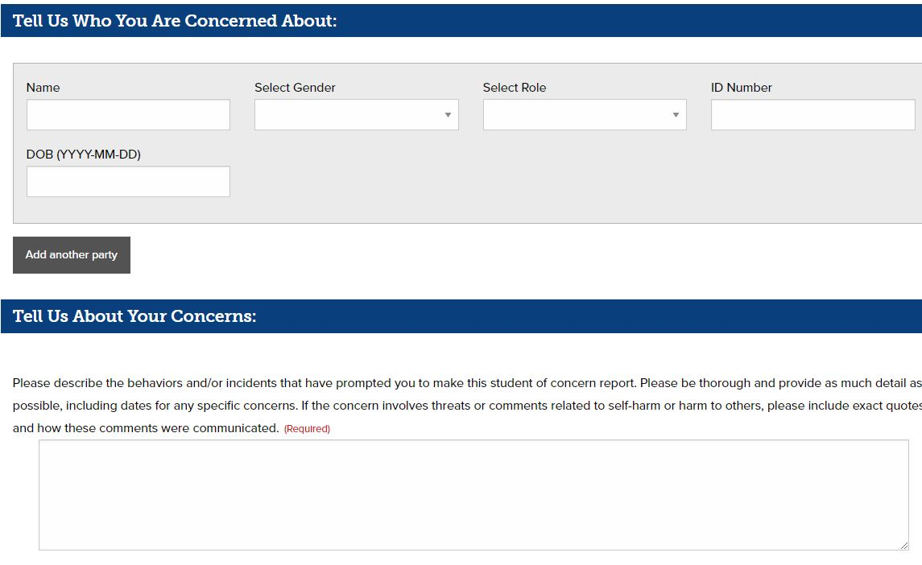
PensacolaState.edu/PiratesCare

Slide 45
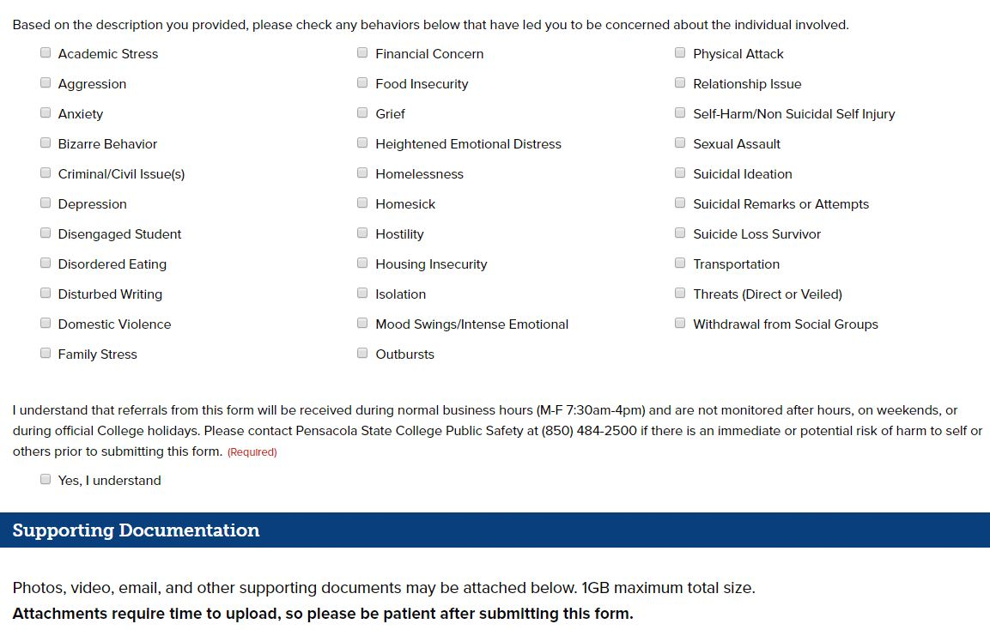
PensacolaState.edu/PiratesCare

Slide 46
REPORT BEHAVIOR TO THE CARE TEAM
It is important to submit reports in a timely manner as soon after the conduct as possible.
Reports can be anonymous, but it is helpful if you do provide your name.
Provide as much information as you have available (it is okay if you don’t have birthdate, id number etc.)
For students, report a name and specific time, day, and class.
For employees, report a name and department.

Slide 47
REPORT BEHAVIOR TO THE CARE TEAM
Report observations and facts, not opinions.
Facts: “appeared agitated” or “made comments about ‘settling the score.’”
Opinions: “he’s crazy” or “she’s dangerous.”
Remember, student reports are education records which must be provided to the student upon request, and employee reports are public records, so provide observable facts only.

Slide 48
STUDENT BEHAVIOR
Reports about students go to the CARE Team for follow-up, threat assessment, and intervention.
The Pirates CARE Team works to “connect the dots” with students of concern.
The Team would rather get 20 reports that need no action than not get a report that indicates potential threat or violence to community or self.

Slide 49


Slide 50
EMPLOYEE BEHAVIOR
Reports about employees are received by the Executive Director of Institutional Equity, the Chief of Police, the Director of Human Resources and the General Counsel. Following review they are forwarded to the appropriate College administrators.
The process for follow-up, threat assessment, and intervention is similar to the process for students.
The compilation of information within Maxient allows us to “connect the dots” with employees of concern.
Again, it is better to get multiple reports of minor behaviors that require no action because the bigger picture may be aggregated from smaller observations.

Slide 51
PSC
Pirates Care Team
Anita Bronson
Rachelle Burns
Kathryn Coxwell
Dr. Ruth Davison
Sean Fagan
Wayne Hagan
Jennifer Hill-Faron
Dr. Katie Hudon
Jessica Johnson
Dr. Lynsey Listau
Dr. Liz Moseley

Slide 52
NEXT STEPS
Create a plan
  Where are your exits?
  What can you use as a weapon?
  Learn surroundings in buildings you typically go to (for meetings, etc.)
Review information on Public Safety website
Report concerning behavior immediately
Encourage colleagues and students to attend training

