Slide 1
Stop the Bleeding! Basic First Aid in Recognizing and caring for minor & severe bleeding
Presented by: Butch Branch
American College of Sports Medicine certified
American Red Cross certified instructor
Milton Campus L.I.F.E. Center
2019 Campus Safety Month

Slide 2
Learning Outcomes
Recognition of bleeding
Minor bleeding (internal/external)
Infection
Types of wounds
Severe bleeding (internal/external)
Impaled/embedded objects
Tourniquets
Practice session

Slide 3
Bleeding
Bleeding - escape of blood (external/internal - aka open/closed wounds) from the arteries, capillaries or veins.
A large amount of bleeding in a short amount of time is called a hemorrhage (hemorrhagic/hypovolemic shock).
Uncontrolled bleeding, whether internal or external is life-threatening.
Blood:
Made up of liquid (plasma) and solid components (white and red blood cells and platelets).
Transports oxygen, nutrients and wastes.
Protects against disease.
Maintains constant body temperature.

Slide 4
The three major types of blood vessels are:
Arteries-carry blood away from the heart, pulses with each contraction of the heart, under greater pressure and travels faster, bright red due to more oxygen.
Veins-returns the blood back to the heart.
Capillaries –smallest of blood vessels, transfer oxygen and other nutrients into the cells and pick up waste products such as carbon dioxide.
Bleeding that is severe enough to critically reduce blood volume (hypovolemic) is life-threatening because tissues will die from lack of oxygen.

Slide 5
Degrees of External Bleeding
External bleeding occurs when a blood vessel is opened externally, such as a tear in the skin.
Each type of blood vessel bleeds differently.
Arterial bleeding is rapid and is severe, is life-threatening, bright red in color.
Venous blood is under less pressure and flows from the wound at a steady rate, dark red in color.
Capillary bleeding is usually slow because the vessels are small. Blood oozes from the wound.

Slide 6
Care for Minor external bleeding
Use a barrier (gloves) between your hand and the wound
Apply direct pressure for a few minutes to control any bleeding
Wash the wound thoroughly with soap and water, gently dry with clean gauze
Apply an antibiotic ointment to the dressing
Cover the wound with a clean sterile dressing
Wash your hands immediately after giving care
Change dressing daily and check for infection.

Slide 7
Infection
Any break in the skin can provide an entry point for microorganisms that can cause infection.
Tetanus – caused by bacteria that produces a powerful poison in the body.
The best initial defense against infection is to clean the area.

Slide 8
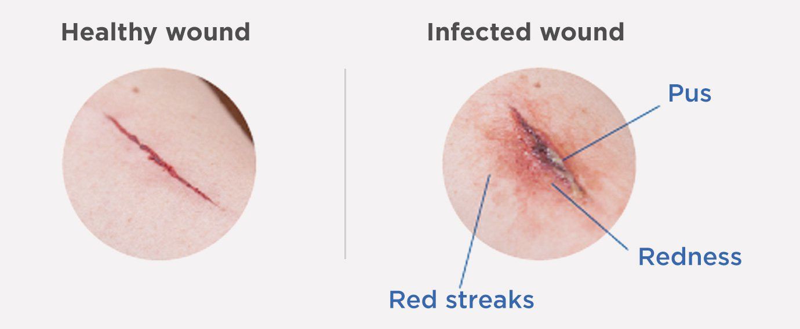
Signals of Infection
Swollen and red
Feels warm and may throb with pain
May have a pus discharge
Develop a fever and feel ill (more serious infections)
Red streaks may develop and progress in the direction of the heart.

Slide 9
Care of Infection
Keep the area (wound) clean
Soak in clean, warm water
Apply an antibiotic ointment or cream
Cover with clean sterile dressings
Continue to monitor the area/wound for signs of infection
If wound appearance worsens seek medical attention

Slide 10
Internal bleeding
Internal bleeding is the escape of blood from arteries, veins or capillaries into spaces within the body.
Severe internal bleeding can occur from injuries caused by blunt force or a chronic medical condition.
Internal bleeding can also occur when an object penetrates the skin and damages internal structures.
Always suspect internal bleeding in any serious injury.

Slide 11
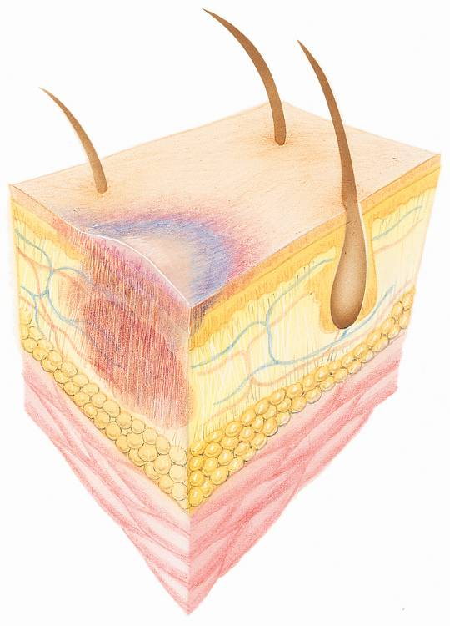
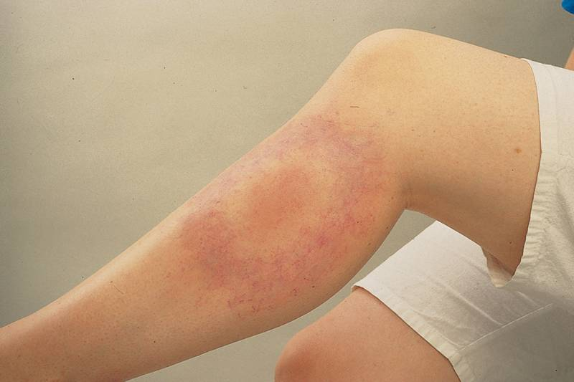
Internal/Closed Wounds
The simplest internal bleeding/closed wound is a bruise, also called a contusion.
Bruises result when the body is subjected to force.

Slide 12
Care for Minor internal/Closed Wounds
To decrease bleeding and to help control pain and swelling:
Apply ice or a cold pack. Place a barrier between the skin and the ice pack, 20/20 minutes, 24/48 hours
Elevate if it does not cause more damage.
Do not assume all closed wounds are minor, take time to evaluate
Call 9-1-1 or the local emergency number if the victim complains of severe pain, cannot move a body part or the injured extremity is blue or extremely pale, vomits/coughing blood

Slide 13
Severe internal bleeding
Internal bleeding is less obvious than external bleeding.
Recognize when a serious injury has occurred, and suspect internal bleeding.
Activate the EMS system immediately, and give care until EMS personnel arrive and take over.
Do not wait for shock to develop before giving care to a victim of injury or sudden illness.
Follow the general care steps for any emergency to minimize the progression of shock.

Slide 14
Signals of severe Internal Bleeding
Signals include—
Soft tissues, that are tender, swollen or hard.
Anxiety or restlessness.
Rapid, weak pulse.
Rapid breathing, shortness of breath.
Skin that feels cool or moist and looks pale, ashen or bluish.
Bruising in the injured area.
Nausea and vomiting or coughing up blood.
Abdominal pain.
Excessive thirst.
A decreasing level of consciousness.
Severe headache.

Slide 15
Care for severe Internal Bleeding
If you suspect severe internal bleeding, call 9-1-1 or the local emergency number
immediately.
Follow these general care steps:
Do no further harm.
Monitor ABCs and consciousness. (airway, breathing, circulation)
Help the victim rest comfortably.
Keep the victim from getting chilled or overheated.
Reassure the victim.
Give any specific care needed.

Slide 16
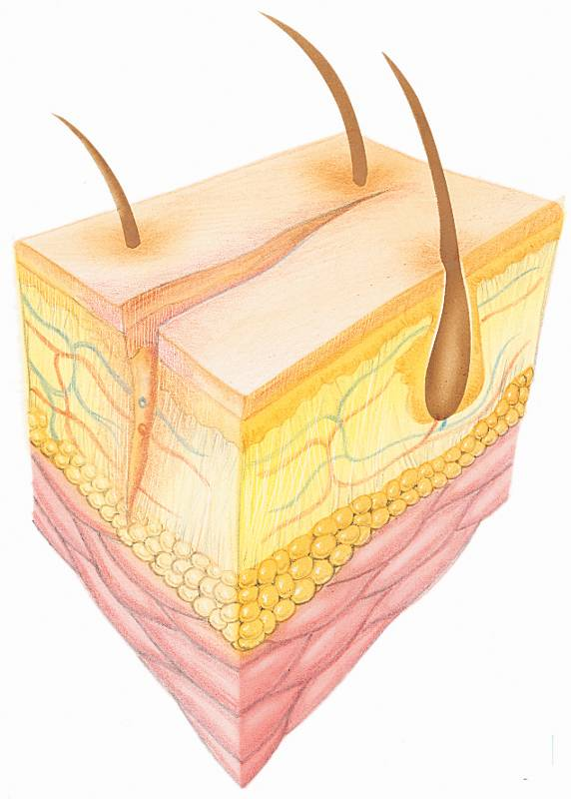
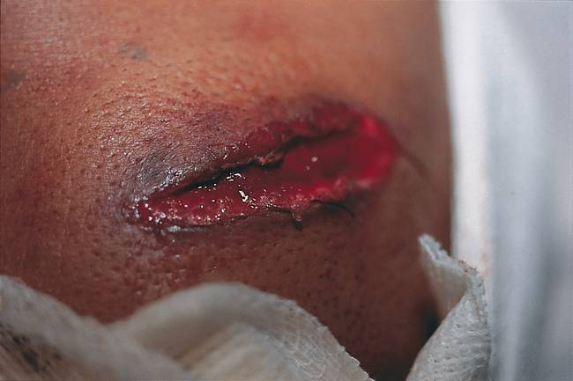
External / Open Wounds
Open wound, break in the skin can be as minor as a scrape of the surface layers or as severe as a deep penetration.
Six common types of open wounds:
Abrasion (rubbing/scrapping)
Laceration (jagged/straight cut)
Avulsion (partial removal)
Amputations (severing of body part)
Puncture (hole)
Crushing (compression)

Slide 17
Severe External Bleeding
Signals of severe external bleeding include:
Blood spurting from the wound.
Bleeding that fails to stop after all measures have been taken to control it.

Slide 18
Severe External Bleeding
Immediate response to bleeding – The ABC’s of bleeding
Alert – call 911
Bleeding – locate the bleeding
Compression – apply pressure
Source – bleedingcontrol.org
www.bleedingcontrol.org

Slide 19
Care for Severe External Bleeding
Use a barrier (gloves) between your hand and the wound.
Cover the wound with a sterile dressing, apply direct pressure.
Apply a pressure bandage.
If bleeding does not stop apply additional dressings and bandages.
Do NOT remove dressings once in place
Call 9-1-1 or the local emergency number if bleeding cannot be controlled.
Continue to monitor the victim’s ABCs.
Tourniquets can be used only after direct pressure becomes ineffective, 2” above the wound.

Slide 20
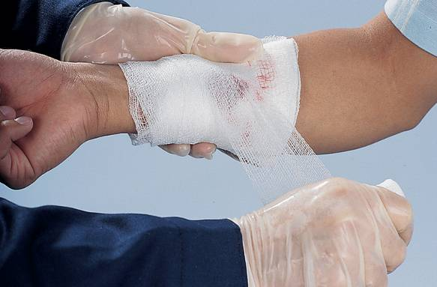
Care for Severe External Bleeding
Apply a roller bandage—
Check feeling, warmth and color.
Secure the end of the bandage.
Do not cover fingers or toes.
If blood soaks through the dressings, do not remove them. Apply additional dressings and another bandage and continue to apply pressure.

Slide 21
Embedded / impaled object
If the victim has an embedded/impaled object in the wound—
Call 9-1-1 or the local emergency number
Put on disposable gloves.
Do not remove the object.
Apply direct pressure to the edges of the wound
Use bulky dressings to stabilize the object.
Control bleeding by bandaging the dressing in place around the object.

Slide 22
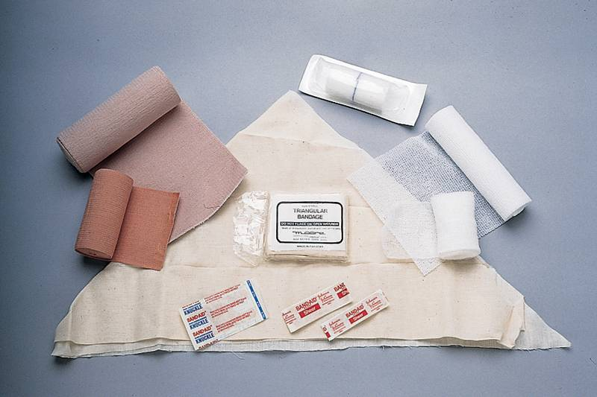
Dressings and Bandages
A dressing is a pad placed directly over a wound to absorb blood and other body fluids and to prevent infection.
A bandage is any material used to wrap or cover any part of the body.
A bandage applied snugly to create pressure on a wound or an injury is called a pressure bandage.
Commonly used bandages:
Occlusive dressing (no longer used)
Bandage compress.
Adhesive compress.
Roller bandage,
Elastic roller bandage.
Hemostatic dressings (preferred)

Slide 23
Start Red Cross video
https://www.youtube.com/watch?v=iCnAIwL1QB0

Slide 24
How to Use a Tourniquet
https://www.youtube.com/watch?v=y81aJ81ln5Q

Slide 25
Video on applying a tourniquet
https://www.youtube.com/watch?v=gufWXaljyII

Slide 28
Let’s practice

Slide 29
Chapter 9 Shock
Shock is a progressive life-threatening condition in which the circulatory system fails to circulate oxygen-rich blood to all parts of the body.
When the body is unable to meet its demand for oxygen because blood fails to circulate adequately, shock occurs.

Slide 30
Types of Shock
Respiratory Shock | Trauma to the respiratory tract (trachea, lungs) that causes a reduction of oxygen and carbon dioxide exchange. Body cells cannot receive enough oxygen.
Neurogenic Shock | Injury or trauma to the nervous system (spinal cord, brain). Nerve impulse to blood vessels impaired, blood vessels remain dilated and blood pressure decreases.
Cardiogenic Shock | Myocardial Infarction with damage to heart muscle; heart unable to pump effectively. Inadequate cardiac output. Body cells do not receive enough oxygen.
Hemorrhagic/Hypovolemic Shock | Severe bleeding or loss of body fluid from trauma, burns, surgery, or dehydration from severe nausea and vomiting. Blood pressure decreases, thus blood flow is reduced to cells, tissue, and organs.

Slide 31
Types of Shock
Anaphylactic Shock | Results from reaction to substance to which patient is hypersensitive or allergic (allergen extracts, bee sting, medication, food). Outpouring of histamine results in dilation of blood vessels throughout the body.
Metabolic Shock | Body's homeostasis impaired; acid-base balance disturbed (diabetic coma or insulin shock); body fluids unbalanced.
Psychogenic/distributive Shock | Shock caused by overwhelming emotional factors. Sudden dilation of blood vessels results in fainting because of lack of blood supply to the brain.
Septic Shock | An acute infection, usually systemic, that overwhelms the body (toxic shock syndrome). Poisonous substances accumulate in bloodstream and blood pressure decreases, impairing blood flow to cells, tissues, and organs.

Slide 32
Signals of Shock
Without intervention, the body’s failed attempt to compensate for blood loss eventually will result in death.
Signals of shock include—
**Apprehension, anxiety, restlessness or irritability.
Altered consciousness.
Pale or ashen, bluish, cool or moist skin.
Rapid breathing.
Rapid and weak pulse.
Excessive thirst.
Nausea and vomiting.

Slide 33
Care for Shock
Follow the emergency action steps, CHECK—CALL—CARE, including calling 9-1-1 or the local emergency number.
To care for shock—
Monitor the victim’s breathing and signs of life.
Control any external bleeding.
Elevate the legs about 12 inches to help blood circulate to the vital organs.
Do not elevate the legs—
If the victim is nauseated or having trouble breathing.
If you suspect head, neck or back injuries or possible broken bones.
If moving causes more pain.

Slide 34
Care for Shock (continued)
Do not give the victim anything to eat or drink, even though he or she is likely to be thirsty.
Help the victim maintain normal body temperature by keeping him or her from getting chilled or overheated.

Slide 35
Chapter 10 Soft Tissue Injuries
Introduction
Millions of people suffer disabling injuries each year.
Thousands of lives are lost each year as a result of injuries.
The more common injuries involve the soft tissues of the body.
Two basic types of injuries are—
Soft tissue injury.
Musculoskeletal injury.

Slide 36
Soft Tissue Injuries
Soft tissues include the layers of skin, fat and muscle.
The skin is composed of two primary layers:
Outer (epidermis)
Deep (dermis)
The epidermis provides a barrier to bacteria and other organisms that can cause infection.
The dermis layer contains the—
Nerves.
Hair roots.
Sweat.
Oil glands.
Blood vessels.

Slide 37
Soft Tissue Injuries (continued)
The hypodermis, located beneath the epidermis and dermis, contains—
Fat.
Blood vessels.
Connective tissues.
The muscles lie beneath the fat layer and comprise the largest segment of the body’s soft tissues.

Slide 38
Wounds
A wound is a physical injury involving a break in the layers of the skin.
Wounds are typically classified as either closed or open.
Closed wound—the soft tissue damage occurs beneath the surface of the skin.
Open wound—has a break in the skin.

Slide 39
Soft Tissue Injuries
Burns
Burns are a special kind of soft tissue injury.
Burns account for about 25 percent of all soft tissue injuries.
Burns break the skin and can cause infection, fluid loss and loss of body temperature control.
The severity of a burn depends on—
The temperature of the source.
The length of exposure to the source.
The location of the burn.
The extent of the burn.
The victim’s age and medical condition.

Slide 40
Rule of Nines Determining % of burns

Slide 41
Causes of Burns
Thermal (heat)
Chemicals (dry and liquid)
Electricity
Radiation (sun, medical device, tanning beds)

Slide 42
Burns (continued)
Burns are also classified by depth:
Superficial (first-degree)
Deep. Deep burns are further classified into—
Partial thickness (second-degree).
Full thickness (third-degree).
Superficial (first-degree) burns involve only the top layer of skin. First-degree burns—
Appear red and dry.
Are usually painful.
May swell.
Generally heal in 5 to 6 days without permanent scarring.

Slide 43
Burns (continued)
Partial-thickness burns (second-degree) involve both the epidermis and the dermis. Partial-thickness burns—
Appear red.
Have blisters that may open and weep clear fluid.
May look mottled (blotched).
Are usually painful.
May swell.
Usually heal in 3 or 4 weeks. Scarring may occur.

Slide 44
Burns (continued)
Full-thickness burns (third-degree) involve all the layers of skin, as well as any or all of the underlying structures—fat, muscles, bones and nerves.
Full-thickness burns—
Appear brown or charred (black), with the tissues underneath sometimes appearing white.
Can either be extremely painful or relatively painless if the burn destroyed nerve endings in the skin.
Can be life threatening.
Take longer to heal and usually result in scarring.

Slide 45
Critical Burns
A critical burn requires the attention of a medical professional.
Critical burns are potentially life threatening, disfiguring and disabling.
Call 911 or the local emergency number if the victim—
Has trouble breathing.
Has burns covering more than one body part or a large surface area.
Has suspected burns to the airway. Note burns around the mouth or nose.
Has burns to the head, neck, hands, feet or genitals.
Has a full-thickness (third-degree) burn and is younger than age 5 or older than age 60.
Has burns resulting from chemicals, explosions or electricity.

Slide 46
Care for Burns
** Check the scene for safety.
Stop the burning as quickly as possible.
Check first for life-threatening conditions.
Call 911 or the local emergency number if burns are suspected to be critical.
Cool the burn with large amounts of cold running water until pain is relieved, for at least 10 minutes.
If possible, remove any jewelry.
Cover the burn.
Take steps to minimize shock.
Comfort and reassure.

Slide 47
Care for Burns (continued)
To care for liquid chemical burns—
Call 911 or the local emergency number (if severe).
** Flush the burn with large amounts of cold, running water for at least 10 minutes or until EMS personnel arrive.
If the chemical is dry or powdered—
Brush the chemical from the skin with a gloved hand.
Flush the residue from the skin with clean running tap water.
If possible, have the victim remove contaminated clothes.
If the chemicals are in the eyes—
** Flush affected eye with cool water until EMS personnel arrive.
Try to prevent the chemical from getting into an unharmed eye.

Slide 48
Care for Burns (continued)
Electrical burns can cause both serious internal and external injuries.
Signals of an electrical injury include—
Unconsciousness.
Dazed, confused behavior.
Obvious burns on the skin’s surface.
Trouble breathing or no breathing.
Burns both where the current entered and where it exited the body, often on the hand or foot.

Slide 49
Care for Burns (continued)
To care for a victim of an electrical burn—
Make sure the scene is safe. The source of the electricity must be turned off.
Check for other hazards.
Call 911 or the local emergency number immediately.
When the scene is safe, check for life-threatening conditions.
Be prepared to give CPR or defibrillation.
Look for two burn sites. These are entry and exit wounds indicating where electricity passed through the body.
Check for additional injuries, such as fractures.
Cover any burn injuries with a dry, sterile dressing.
Take steps to minimize shock.

Slide 50
Care for Burns (continued)
To care for a victim of a radiation burn caused by the sun—
Cool the burn for at least 10 minutes, (examples: cool water, shower).
Prevent further damage by staying out of the sun or wearing a protective lotion or clothing.
Ask your doctor or pharmacist for recommendations on products for sunburn care.
Do not break blisters. Intact skin helps prevent infection.

Slide 51
Thank you !
Questions?
Stay safe
Best of Health……………..

