Slide 1

Phone System User
Training Session

Slide 2
Introduction and Agenda
Trainer Information
  Mike DuPhily, Engineer, Verteks Consulting
  ShoreTel Advanced Certified Engineer
  help@verteks.com, 877-VERTEKS
Session Information
  Introductory session with a focus on core features
  Interactive demonstration system for one-on-one
Training Options Available to You
http://www.pensacolastate.edu/helpdesk/helpdesk-staff/new-college-phone-system/

Slide 3
What To Expect
We’ve done our best to keep everything working as smoothly as possible during the transition to the new phone system.
There are some features of the ShoreTel system that are entirely new and some things that will work differently from your current phone or software.
We will highlight these changes for you during this training.
If you have any particular concerns or questions that you would like to be addressed, please feel free to ask about them during this training, or discuss them with myself or your IT staff after this training or at any time.
We’ve found that it generally takes about a month to get comfortable with the new system. There are many new features and options to explore. These are all completely optional – make use of as many or as few of them as you’d like. No pressure.

Slide 4
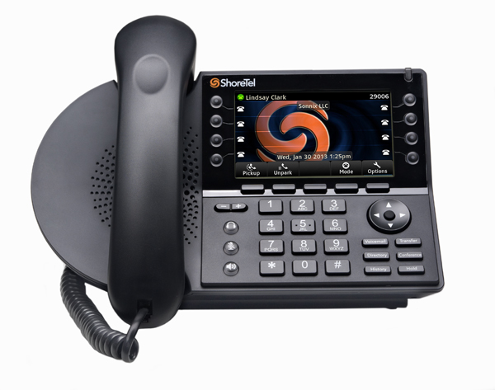
About The Handset – IP485
8 Programmable Buttons
6 Feature Keys
(Transfer, Conference, Directory, History, Voicemail, Hold)
Color Display
Full Duplex Speakerphone
Audio Controls – independent for ringer, handset and speaker, Headset Jack, Mute (LED)

Slide 5
Your ShoreTel IP phone's display shows your name and extension, call forwarding state, duration of call, voice messages, and date and time.

Slide 6
Basic Functions - Overview
After completing this section, you will be able to:
Place calls using the handset, speakerphone, or headset
Answer calls using the handset, speakerphone, or headset
Use the Directory and History features.
Transfer a call to another user or outside line.
Create conference calls.

Slide 7
Basic Functions – Place Calls
Using the Handset - To place an internal call, pick up the handset and dial the extension. To place an external call, dial 9, then the phone number. To end a call, hang up the handset.
Using the Speakerphone - To place an internal call, press the Speakerphone button and dial the extension. To place an external call, dial 9, then the phone number. To end a call, press the Speakerphone button again.
Using the Headset - To place an internal call, press your headset's answer button (on the headset) and dial the extension. To place an external call, dial 9, then the phone number. To end a call, press the headset's answer button again.

Slide 8
Making it Easy to Place Calls
Remember: You no longer need to dial “7” for long distance calls.
Just dial “9” and the system will route the call out through the appropriate line.

Slide 9
Basic Functions – Answering Calls
Using the Handset - To answer a call, pick up the handset when the phone rings. To end a call, hang up the handset.
Using the Speakerphone - To answer a call, press the Speakerphone button . The LED in the button lights green. To end a call, press the Speakerphone button again.
Using the Headset - To answer a call, press the headset's answer button . The LED on the phone's Headset button lights green. To end a call, press your headset's answer button again.

Slide 10
Basic Functions – Directory
You can use the Directory to find an extension by name. Press the Directory button and use the scroll key to move up and down through the list.
You can also search the Directory by spelling any part of the name of the person you are looking for.
  For instance, if you were looking for Mike, you would press 6-4-5-3 on the keypad.
  Note that you do not have to press the keys multiple times to dial a letter.

Slide 11
Basic Functions – History
You can use the History function to dial calls you have received or placed recently. Calls made to your phone that you missed also appear here.
To dial from History, press the History key, then use the scroll keys to find the correct entry and press the Select button OR pick up the handset/headset.

Slide 12
Basic Functions – Transfer A Call
To transfer a call from your extension to another number:
Step 1: Press the Transfer button . The call is put on hold.
Step 2: Dial the extension or external number (remember to dial 9) or use the Directory key, then do one of the following:
  Complete a blind transfer by hanging up or by pressing the Transfer key again.
  Stay on the line after entering the number to speak to the recipient before transferring. After consultation, to hang up press the Transfer key to complete the transfer.
  If you'd like to cancel the transfer and return to the original caller, press the blinking call appearance button to take original caller off hold.

Slide 13
Basic Functions – Conference Call
You can create a conference call with up to 6 parties max (yourself and 5 others)
To create a Conference Call:
Step 1: Press the Conference button . The call is put on hold.
Step 2: Dial the extension or external number (remember to dial 9) or use the Directory key, then do one of the following:
  Complete a blind conference by pressing the Conference key again.
  Stay on the line after entering the number to speak to the recipient before conferencing. After consultation, press the Conference key to add the party.
  Another option:
  Step 1: Press an available line appearance key to get new dial tone.
  Step 2: Dial the extension or external number.
  Step 3: Once the other party answers, press the Join softkey to combine the 2 calls into a conference call. This process can be repeated until you reach 6 parties.

Slide 14
Using Voicemail
After completing this section, you will be able to:
Use the Voicemail application on your phone.
Access the prompts for additional options.
Setup your voicemail and retrieve messages.

Slide 15
Using Voicemail - Login
A steady flashing light on your phone’s right-most upper corner and ‘stutter’ dial tone signifies that you have unheard voicemail messages. The number of unheard messages appears on the idle screen of your phone’s display by the voicemail icon
To login to the main voicemail prompts, press the Voicemail button, the Call VM softkey, then dial your password followed by #. (Your default password is 1234)

Slide 16
Moving your Extension
To move your extension temporarily to another phone:
Press the Options button on the phone you wish to use.
Press the Assign softkey and enter your extension and password and press OK.
When you are finished using the phone, press the Unassign softkey.

Slide 17
Using Voicemail - Login
Log into voicemail system from another phone:
To log in to the main voice mail menu from another extension, press the Voicemail button, followed by #, then your extension, followed by your password, and then #
To log in to the main voice mail menu from an external phone, dial your own direct line, wait for your voicemail to pick up, then press *, then #, then your extension, then your password followed by #.

Slide 18
Using Voicemail – Record Name & Change Password
Log into the voicemail system
Choose Option 7 to Change Mailbox Options
To change your password, press “4”
To record your name announcement, press “6”
  Press # when finished
  (# to accept, 1 review, 2 re-record, 3, delete, * cancel)

Slide 19
Using Voicemail – Record Greetings
Log into the voicemail system
Choose Option 7 to Change Mailbox Options
To record a greeting – press 1
  (# to accept, 1 review, 2 re-record, 3, delete, * cancel)
You have recorded a greeting for your current ‘call handling mode’
To record greetings for other call handling modes, change your mode first, then record the greeting

Slide 20
Using Voicemail – Call Handling Modes
Log into the main voicemail menu
Choose Option 7 to Change Mailbox Options
To change mode – press 2, then select mode
  1 is Standard Mode
  2 is In A Meeting Mode
  3 is Out of Office Mode
  4 is Extended Absence Mode
  5 is Custom Mode
  6 No Change
  * Cancel
Remember – each mode can have its own custom greeting and other options. Other options are set from the Communicator Software

Slide 21
Quirks and Differences
You don’t need to dial “7” to call long distance if you have had to previously. You need to dial “9” to get an outside line for both local and long distance calls.
The ShoreTel Directory will only show users who have been added to the ShoreTel system. It will not show Lync or Harris system users. You can still reach those users from the ShoreTel system by dialing their extension.
For the duration of the installation your outside caller ID will appear as the school’s main number: (850) 484-1000. This is only temporary. Once the transition to the new system is complete, caller ID will work normally.
Internal caller ID from the Harris system will appear as “+1 XXXX” instead of just the 4-digit extension. This is only temporary and all caller ID will work normally after the deployment is complete.
Internal calls between users on the old phone system and the ShoreTel system will have a small amount of static. This is only temporary.

Slide 22
ShoreTel Communicator
The ShoreTel Communicator software allows users to manage every aspect of their business voice communications with customized call handling features that eliminate time-consuming tasks and maximize productivity.
This simple, easy-to-use application provides call control integrated with calendars and direct visual access to both voice and e-mail messages from a familiar Microsoft Outlook desktop interface.
Key Features
Visual Voice Messaging
Personalized Call Handling
Instant name lookup from system directory and Outlook contacts

Slide 23
Communicator Resources
Additional training resources and reference guides are available on www.shoretel.com:
Self-paced user guide with step-by-step instructions
Online training with audio and video guidance
Internal help resources within the program

Slide 24
Personal Communicator Login
The information you will need to login when you start the program for the first time is:
Server: SG-SHORETEL
Username: Make sure “Use Windows Credentials” is checked (it should be by default)
Press Next
Keep the defaults for the remaining settings and press Next, then Finish.

Slide 25
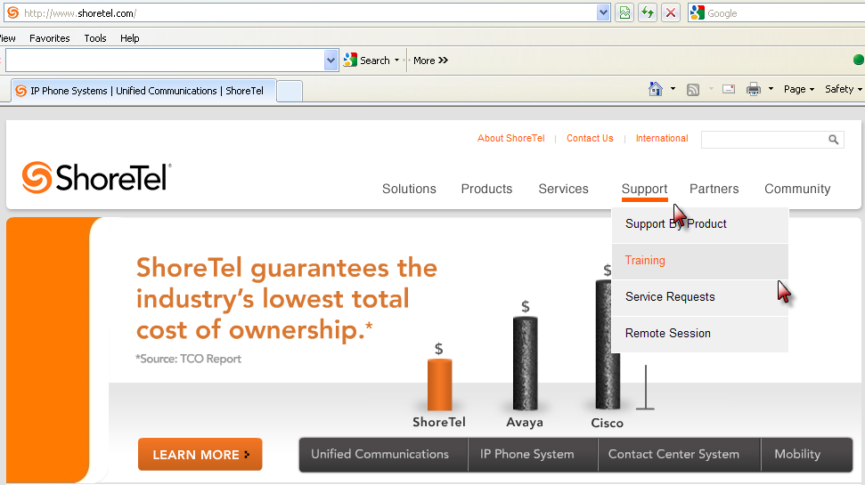
Online Training Access
www.shoretel.com – choose Support > Training

Slide 26

You can access on-line phone training at any time: http://support.shoretel.com/training/ , Then Choose End User Training then Communicator and IP Phones – Self-Paced Training

Slide 27
Conclusion
Review available training resources to follow-up after this session
Experiment with features when possible to learn more about the systems capabilities
THANK YOU FOR TAKING TIME TODAY!
Mike DuPhily, Engineer, Verteks Consulting
help@verteks.com , 877-VERTEKS

