Slide 1
PENSACOLA STATE COLLEGE FOUNDATION
Board Orientation
Notes:
First found as an entry in the dictionary in 1948.

Slide 2
Welcome and
Introductions
Notes:
First found as an entry in the dictionary in 1948.

Slide 3
Definition of Public Comprehensive
Community College
Public
Usually organized under state legislation
At least partly funded by state/local tax revenues
Non-sectarian
Comprehensive
Collegiate, university transfer instruction
Occupational instruction
Non-credit/community instruction
Student services
Serves a broad range of students
Community
Serves adult education; non-traditional students
Focuses on community needs
Identified with a locality
College
Institution of higher education
Faculty must meet full university standards
Curriculum must, in part, be transferable
Notes:
First found as an entry in the dictionary in 1948.

Slide 4
Other Common Attributes:
Open door admissions policy
Relatively low tuition
Developmental education
Student centered
Emphasis on adult education of many types
Emphasizes easy access
Overriding focus on learning
Emphasizes wide variety of programs
May be a multi-campus institution or part of a multi-institutional system

Slide 5
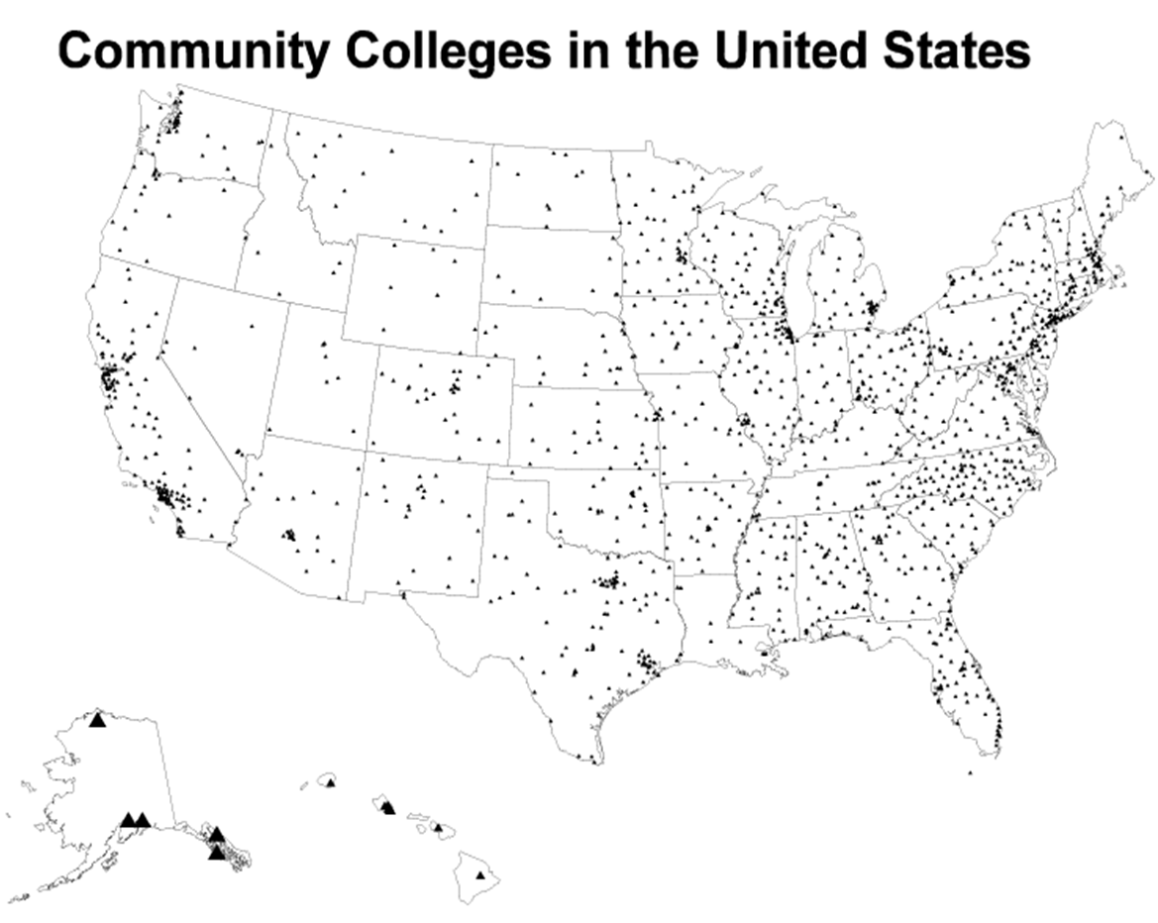
Source: American Association of Community Colleges (AACC), www.aacc.nche.edu

Slide 6
5 Principles to Development of Florida Community College System
Local control is an essential part of good community junior college operation
Joint financial support from both state and local areas is important in providing adequate support and in encouraging local initiative.
The community junior college can be expected to develop most effectively if it fits into the established pattern of school administration of the state.
A broad concept of programs and functions is necessary to the philosophy of a good community junior college.
Continuous examination and analysis of this level of education to determine the need for improvement in all phases of the community junior college program is essential.
--James L. Wattenbarger, 1957

Slide 7
Criteria for Designating Areas
No area should be smaller than one county
When more than one county is considered, no area should, in general, have a longer than 30 mile travel radius for commuting to and from an institution
Potential enrollment should be no less than 400 full time students
Growth potential of the area should be high if the area is near the lower limits of any criteria

Slide 8
Florida College System
28 public state colleges in the Florida College System
Governed by local boards
26 currently approved by the Florida State Board of Education and SACSCOC to offer baccalaureate degrees
Administratively, the Chancellor of Community Colleges is the chief executive officer of the system, reporting to the Commissioner of Education who serves as the chief executive officer of Florida's K-20 System.
Policy of Florida's College System generates from activities of the State Board of Education (SBOE)
Authorized by the Florida Legislature; SBOE meets monthly to discuss policy and consider and approve system decision items

Slide 9
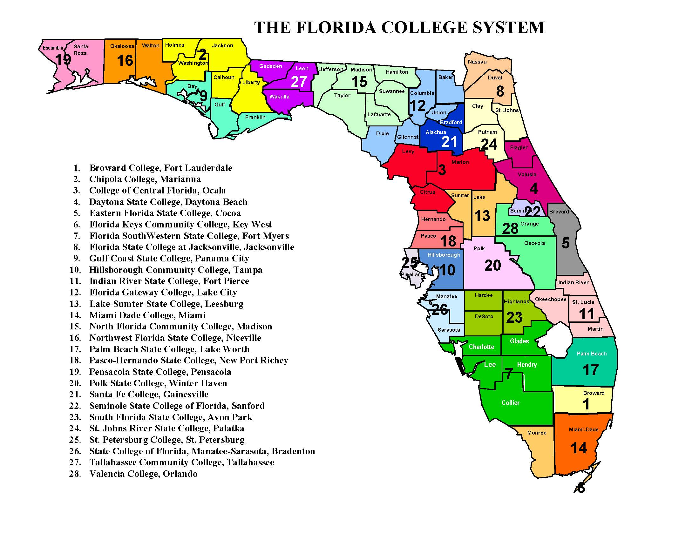

Slide 10
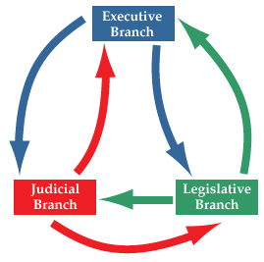
Florida Government Relations
THREE BRANCHES OF GOVERNMENT
Executive
Legislative
Judicial

Slide 11
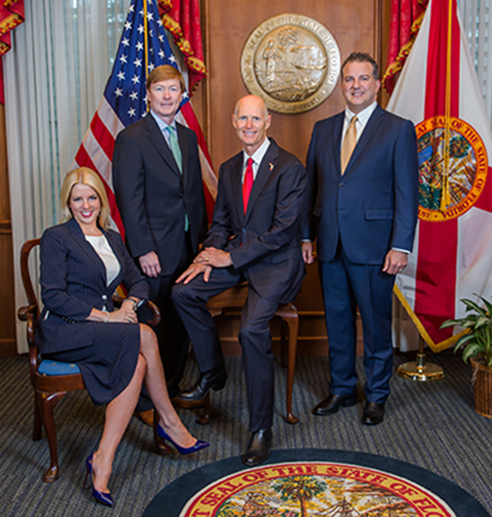
Florida Government Relations
EXECUTIVE: FLORIDA CABINET
Governor Rick Scott
Attorney General Pam Bondi
Comm’r of Agriculture Adam Putnam
Chief Financial Ofc. Jimmy Patronis
http://cabinet.myflorida.com/

Slide 12

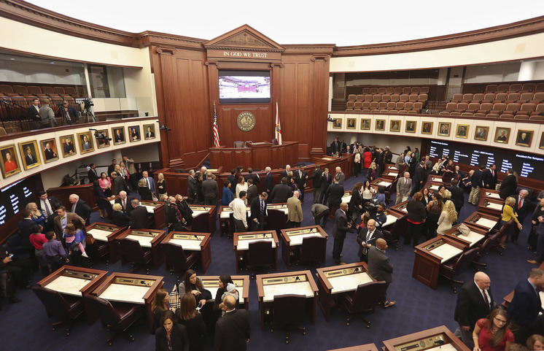
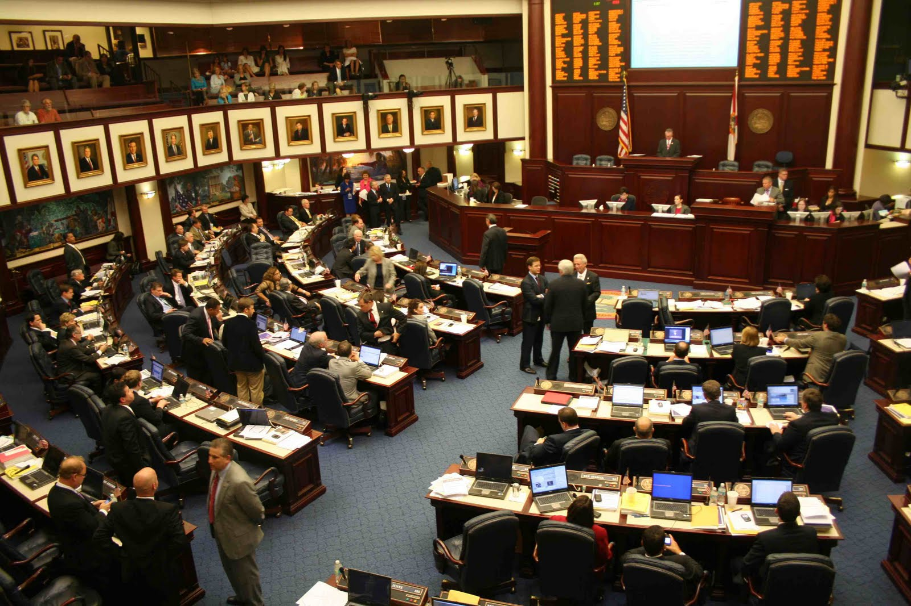

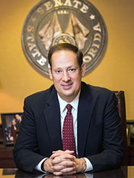
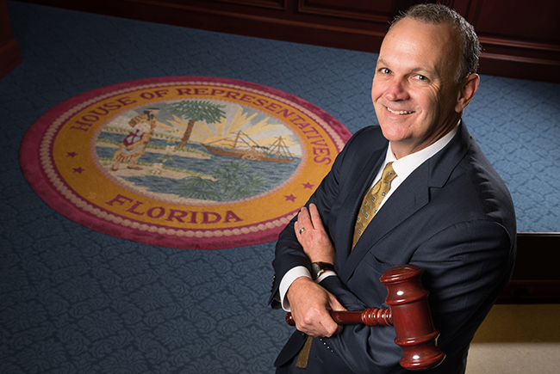
Florida Government Relations
120 Members of the House
Elected to 2 year terms
Speaker of the House:
Richard Corcoran
(R- Land O' Lakes)
40 Senators
Elected to 4 year terms
Senate President:
Joe Negron
(R- Palm City)

Slide 13
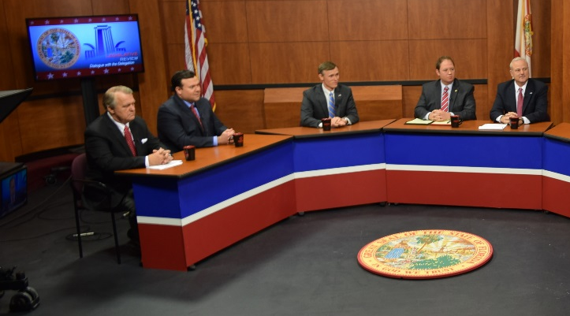
Florida Government Relations
House District Map
District 1: Rep. Clay Ingram
District 2: Rep. Frank White
District 3: Rep. Jayer Williamson
District 4: Rep. Mel Ponder
Senate District Map
District 1: Senator Doug Broxson
District 2: Senator George Gainer
Watch Legislative Review on WSRE December 12 at 7pm

Slide 14
Division of Florida Colleges: Mission
a dynamic and responsive Department of Education team
provides leadership and advocacy
promotes education innovation and continuous improvement within The Florida College System
fueling economic development for the state and its citizens.
Florida's colleges remain the primary point of access to higher education in Florida
65% of high school graduates pursue postsecondary education at a Florida college
82% of freshman and sophomore minority students in public higher education attend one of Florida's colleges.

Slide 15
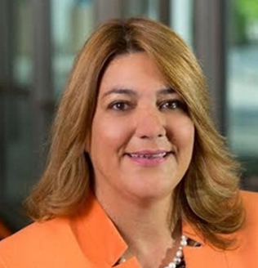

Chancellor of the Florida College System:
Madeline M. Pumariega
Chancellor since 2015
Prior President and Chief Executive Officer of Take Stock in Children
Prior leadership roles at Miami Dade College for more than two decades
Mission
Provide access to quality higher education
Affordable academic and career programs
Develop a globally competitive workforce
Respond rapidly to diverse state and community needs
28 colleges serving nearly 800,000 students!

Slide 16
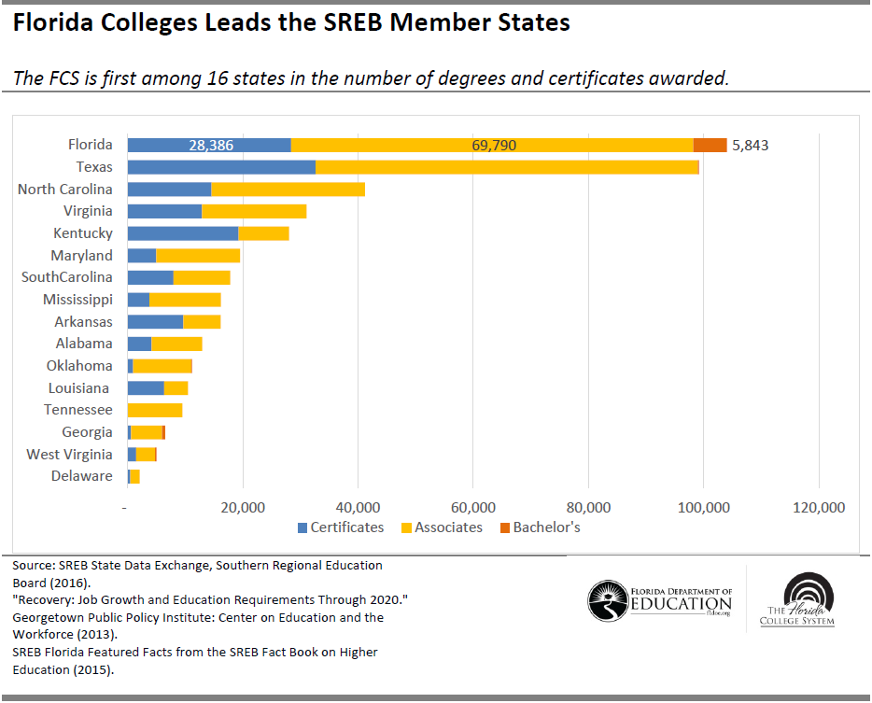
Front of the Graduation Line

Slide 17
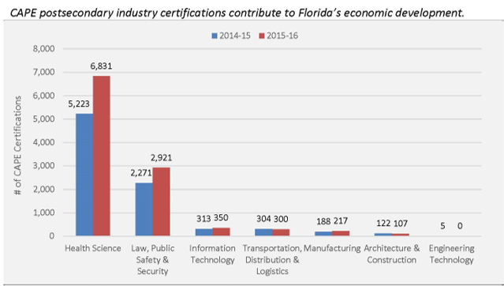
Contributions to Florida’s Economy

Slide 18
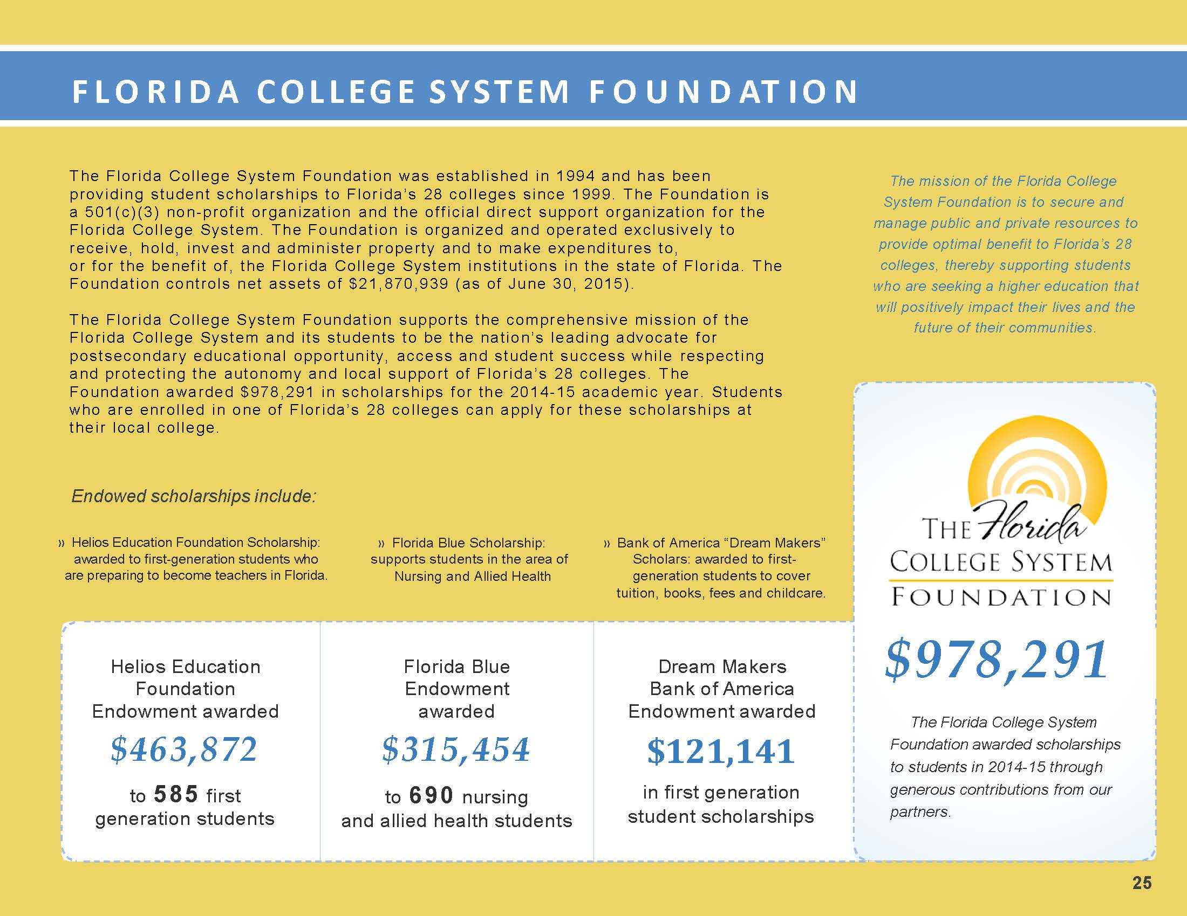
Notes:
Most recent published report from the FCS Foundation is the 2015 Annual Report—FCS along with local college foundation provides scholarship monies to students.

Slide 19
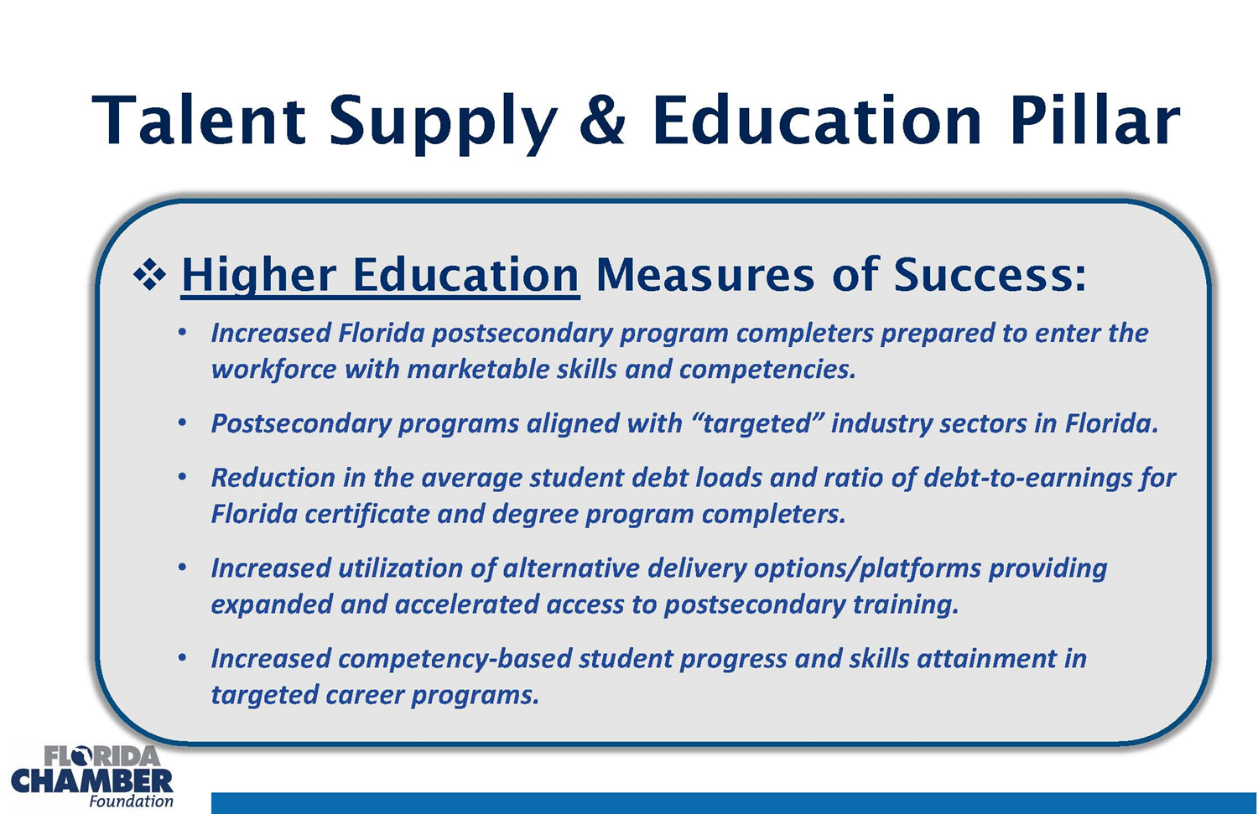

Slide 20
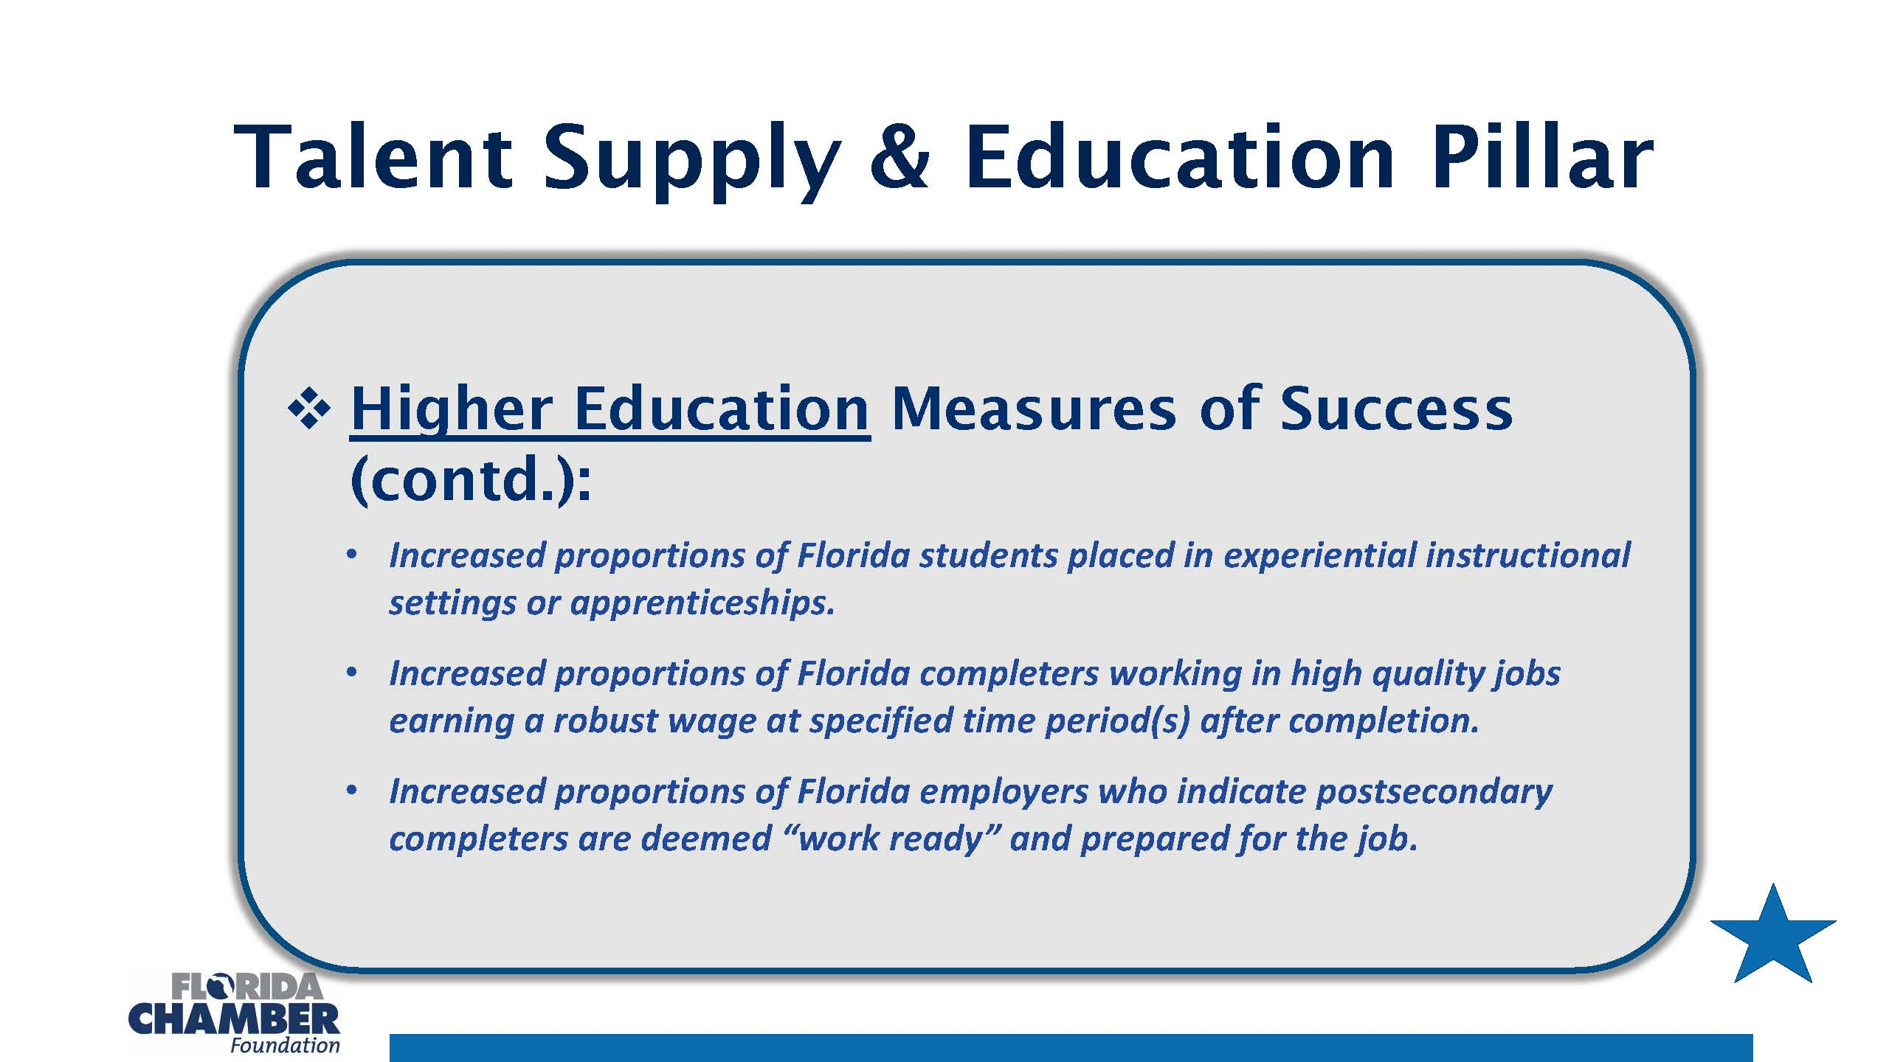

Slide 21
Florida/Pensacola State College Milestones
1947: Florida junior college enabling act, Minimum Foundation Program law, recommended that junior colleges become part of local school systems supported by government funding.
1948: Pensacola High School leaders – Principal James L. McCord, Dean Jesse Barfield, and teacher Margaret Andrus – completed necessary documents for a new junior college and wrote PJC’s first college catalog
September 13, 1948: PJC held its first day of classes in a boarding house on the southeast corner of Palafox and Cervantes streets.
1948-1949: 136 students enrolled; 7 graduate
1949: PJC Firsts – basketball team, student newspaper (The Beachcomber) and yearbook (The Tide)

Slide 22
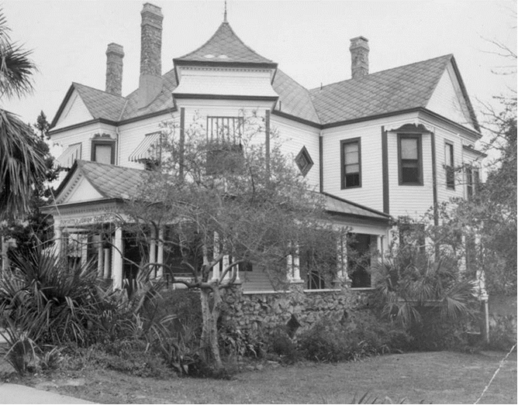

Slide 23
1955: Community College Council of Florida established by Legislature
1957: The Community Junior College in Florida’s Future, The Report to the State Board of Education by the Community College Council
1965: Merger of PJC with Booker T. Washington Junior College, the first black junior college built in Florida and serving the black community since 1949
1968: Florida legislature passed a bill changing authority over community colleges from local boards of advisors who reported to county school boards to local boards of trustees who reported to the State Board of Education
1970: All Florida colleges – “junior colleges”

Slide 24
1998: PJC - 50th Anniversary
2002: One Florida college – “junior college”
2008: PJC - 60th Anniversary
July 2010: Pensacola State College
January 2011: Implementation of Pensacola State College’s first two baccalaureate programs: BSN and BAS in Administration & Supervision
2013: PSC – 65th Anniversary
2017-2018: SACSCOC 10-year Reaffirmation

Slide 25
PSC Points of Pride
Provide access to quality higher education
  FCS First Generation Scholarship: >40% of PSC students enrolled in Fall 2016 were the first in their family to attend college.
  Victory Media – Military Friendly, Silver Award Level, 2012-2017
  2017 won the National Bellwether Award from a field of 2500 entries
  2018 placed in Top 10 for the National Bellwether Award
Affordable academic and career programs
  US Dept. of Ed. 22nd Most Affordable College in the Nation
  US Dept. of Ed. 69th Lowest Net Cost in the Nation
Develop a globally competitive workforce
  Community College Week No.79 in Top 100 Degree Producers 2016
  2018 students win 74 Addy Awards (up from 52 in 2017)
Respond to state and community needs
  SkillsUSA Model of Excellence – Nat’l Recognition 2016
  US News and World Report - Best Colleges 2018 Ranked No. 4 in Public Colleges in the Southern Region (ranked highest in Florida)

Slide 26
Six Convenient Locations: https://youtu.be/RZ5GVTefgEI
Pensacola Campus https://youtu.be/iM3nrSKk-2Q
Cybersecurity,
Bachelor of Applied Science in Administration and Supervision
Warrington Campus https://youtu.be/EnZDSPPtNU0
Health (Mary Smart Simulation Center)
Bachelor of Science in Nursing
Milton Campus https://youtu.be/IVQsIjBw3d4
Welding Program
Cosmetology Program
Joint Campus with UF-Horticulture
South Santa Rosa Center
Dual Enrollment
GED
LEED Certified Building
Century Center
Welding
GED
Downtown Center
Corporate Training Programs
Florida West and Co-Lab

Slide 27
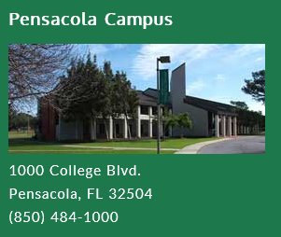
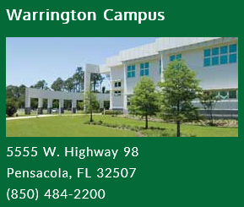
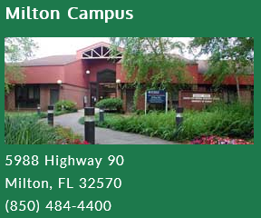
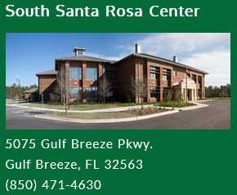
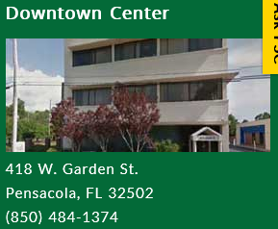

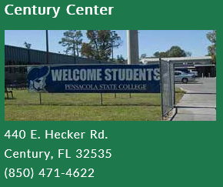
Pensacola Campus
President-Dr. Ed Meadows
VPs=Dr. Erin Spicer & Tom Gilliam; AVP= Sandy Cessaretti Ray
Cybersecurity, Baars Building Rebuild- Building 1
BS in Administration and Supervision
Anna Lamar Switzer Center- Charles Lamar Studio Rebuild
Foundation Offices
Warrington Campus- Dean: Dr. Dusti Sluder
Health (Mary Smart Simulation Center)
Bachelor of Science in Nursing
Milton Campus: Dean- Dr. Anthea Amos
Welding Program
Cosmetology Program
Festival of Flowers and Lumberjack Festival
Joint Campus with UF-Horticulture
South Santa Rosa Campus: Director=Ms. Karen McCabe
Dual Enrollment
GED
LEED Certified Building
Century Center: Director=Ms. Paula Byrd
GED
Downtown Center: Director= Ms. Ruth McKinnon
Corporate Training Programs

Slide 28
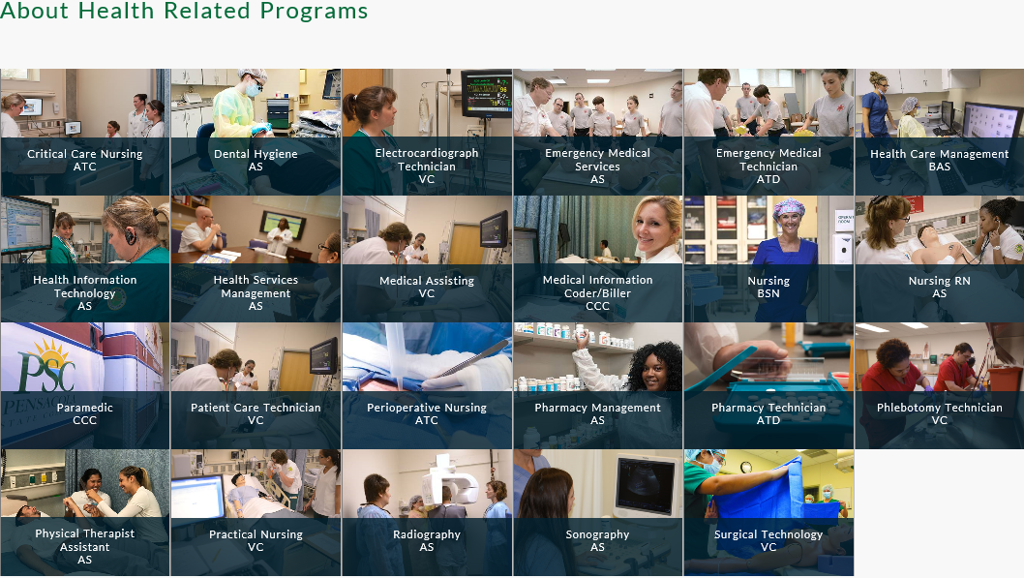

Warrington Campus
Health (Mary Smart Simulation Center) - $456,000 for 11 simulators
RN and BSN Programs
Veterinary Science – Vet Tech Program
https://youtu.be/EnZDSPPtNU0

Slide 29

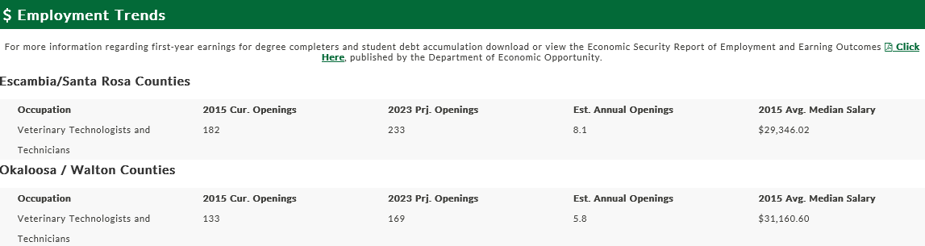
Warrington Campus
Health (Mary Smart Simulation Center)
RN and BSN Programs
Veterinary Science – Vet Tech Program

Slide 30
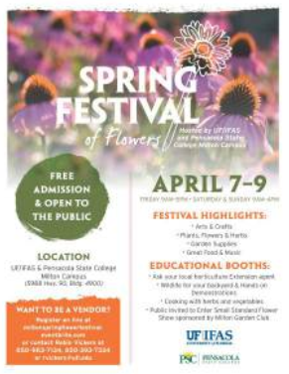
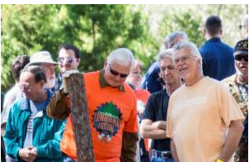

Milton Campus
Welding Program
Cosmetology Program
Festival of Flowers and Lumberjack Festival
Joint Campus with UF-Horticulture
Lumberjack Festival 2018 Coming March 3, 2018

Slide 31
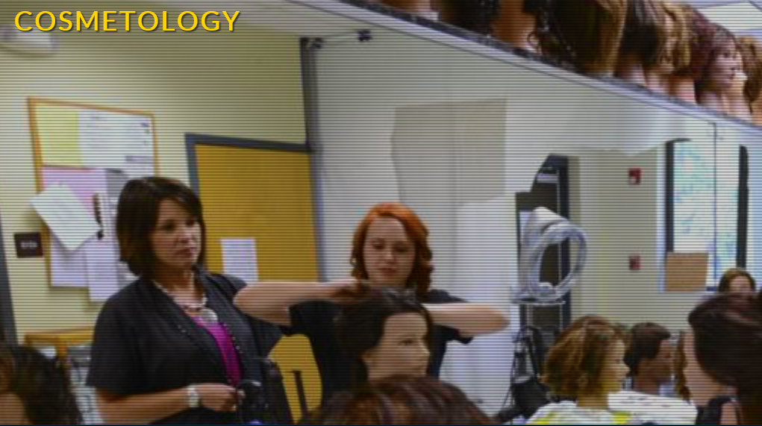
Milton Campus
Cosmetology Program
Cosmetology is a twelve-month, 1200 clock hour program of study that prepares students for State licensure and employment in the areas of hair, nail, and skin care. Classes begin in August, January, and May and are limited to spaces available. The Cosmetology program is offered on the Pensacola and Milton campuses.

Slide 32


Milton Campus
Cosmetology Program
The Advanced Welding Technology Vocational Certificate (VC) Program
This post-secondary adult vocational program prepares students for entry as a class B level welder. Students applying for this program are expected to have completed an Applied Welding Technology course, or have significant experience in the welding field. The program uses a combination of theoretical, simulation and hands on instruction. Strong emphasis is placed on safety as well as specific welding techniques and skills in an effort for students to obtain industry certifications. Students successfully progressing through the program will earn Welder Level 3 Certification issued by National Center for Construction Education and Research (NCCER) and are prepared to test to become certified through the American Welding Society. The full program is designed to be completed in 750 clock hours. Students are responsible for supplying personal protective equipment (PPE) and basic hand tools that are standard in the welding profession.

Slide 33

Milton Campus
Introduction to the Natural Resource Conservation Associate in Arts (AA) - University Transfer Program
This program of study offers the first two years of a baccalaureate degree program in forestry, wildlife ecology or resource conservation. Working in close cooperation with an academic advisor, Natural Resource Conservation students prepare programs of study according to their educational career goals, or they follow one of several specialized options. Natural Resource Conservation graduates find employment in government agencies, consulting firms and environmental education programs. This program was developed with agreement from several leading universities in forest studies including the University of Florida, Auburn University, University of Georgia and Mississippi State University. Two plus two scholarships between Pensacola State College and the University of Florida are also available each year to graduating high school seniors.

Slide 34
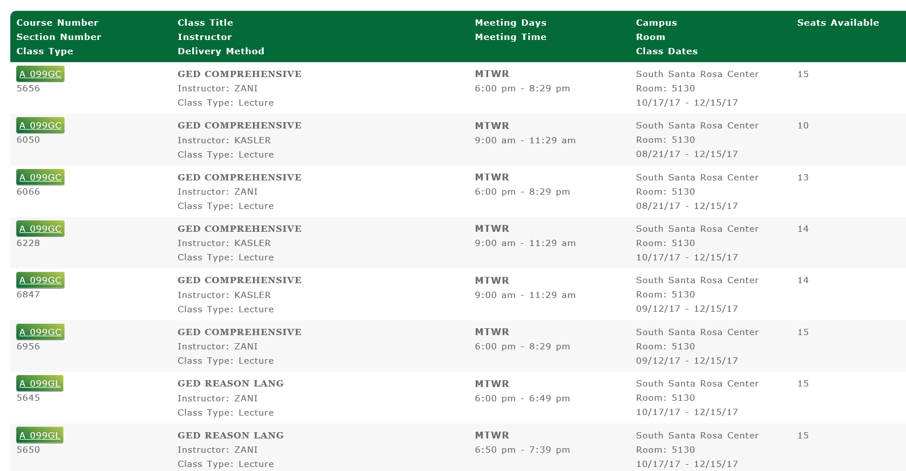
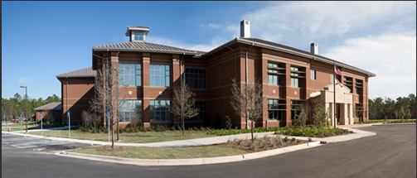
South Santa Rosa Center

Slide 35
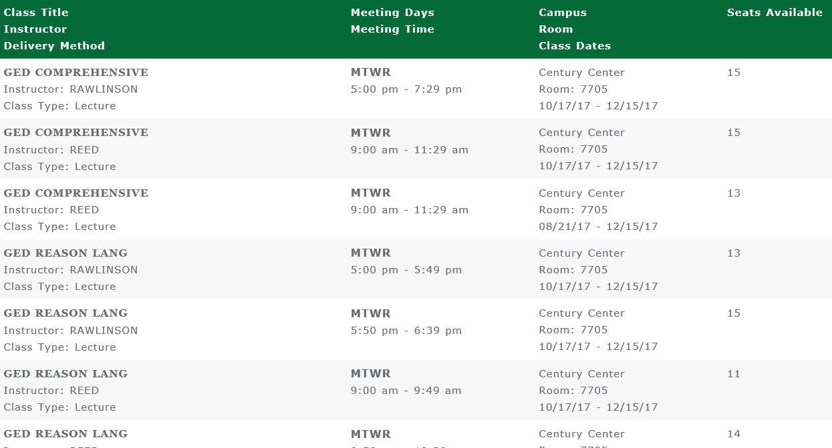
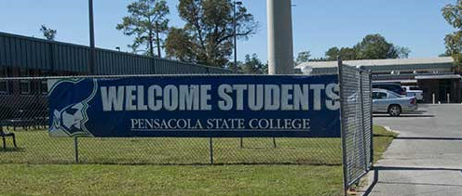
Century Center

Slide 36
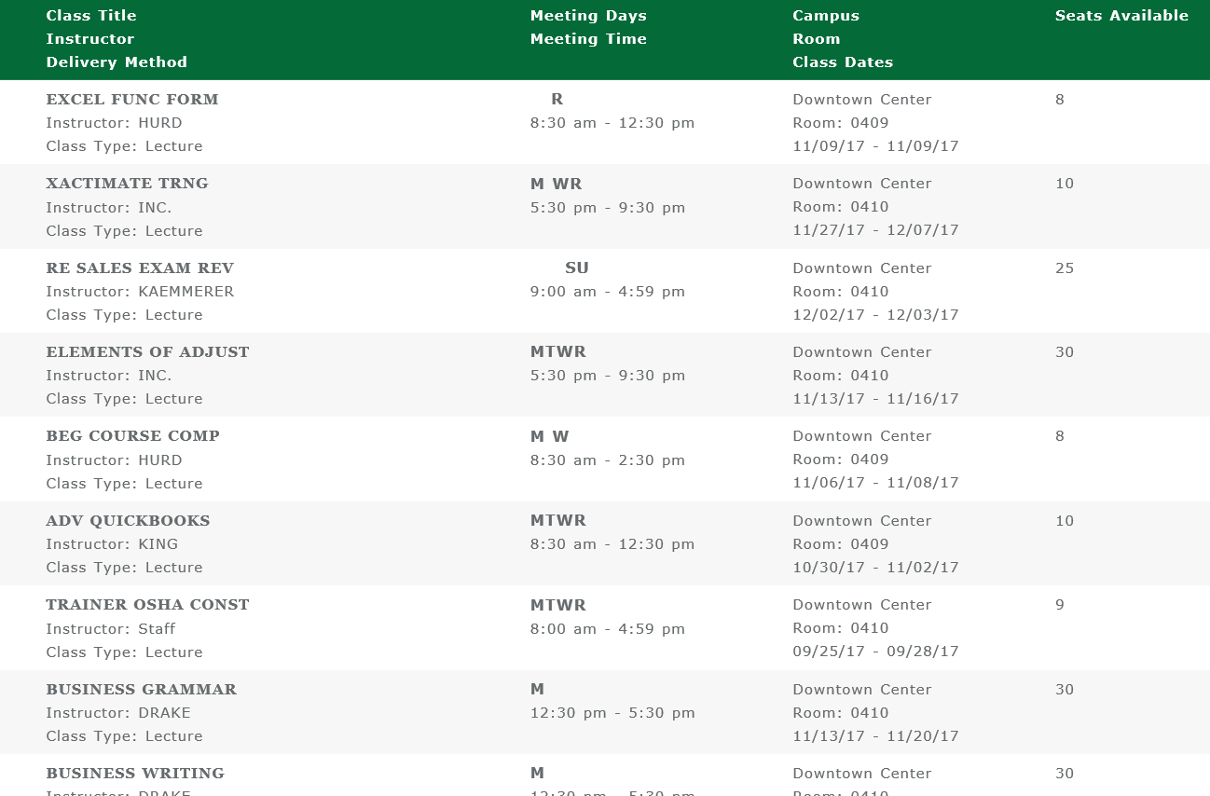
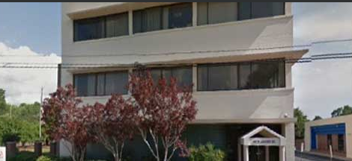
Downtown Center

Slide 37
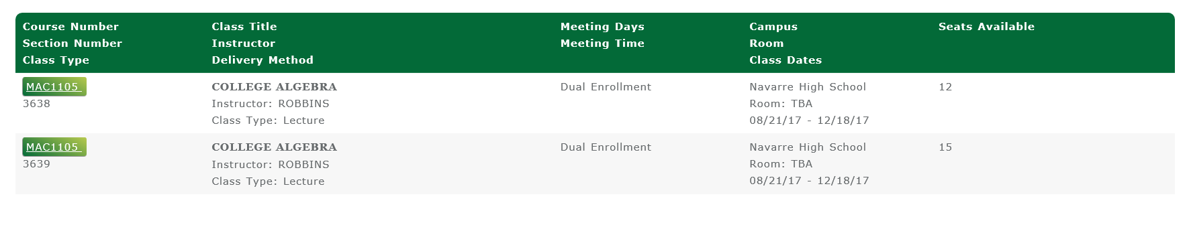
Dual Enrollment
Navarre and Gulf Breeze High Schools

Slide 38
Estimated Revenue Sources
Revenue Sources | National | Pensacola State
 | 2013-2014 | 2013-2014
Federal Funds | 14.1% | 25.3%
State funds | 29.8% | 41.8%
Tuition/Fees | 29.5% | 26.5%
Local funds | 18.1% | 1.0%
Other (includes federal support, gifts, use of facilities, auxiliary funds, etc.) | 8.4% | 5.4%
Source: AACC; PSC Business Office
Notes:
Disequalization caused by local property taxes in funding per student was the principal reason the Florida Legislature chose to prohibit this revenue source in 1968.

Slide 39
Tuition/Fee Comparison
 | In-State (and/or In-District) Tuition/Fees for 24 hours
State/Community College | 2016-2017
California/all | $1,175
Oregon/Oregon Coast Community College | $3,816
Florida/Pensacola State College | $2,509
Maine/all | $3,810
Alabama/Jefferson Davis Community College | $3,968
Indiana/Ivy Tech Community College | $4,055
Idaho/College of Western Idaho | $1,668
Virginia/Germanna Community College | $3,818
Iowa/Iowa Western Community College | $4,560
New York/Queensborough Community College | $4,840
New Hampshire/Manchester Community College | $3,866
Vermont/Community College of Vermont | $6,072

Slide 40
Personal Benefit
Student’s ROI (benefits less the cost of the original investment divided by total cost) comes to a net of $3.80 in additional benefits over and above every $1 paid.
The average annual internal rate of return for students is 17.8%.
(AACC)

Slide 41
Social Benefit
For every dollar that federal, state, and local taxpayers spent on America’s community colleges, society as whole in the U.S. will receive a cumulative value of $25.90 in benefits, for as long as the 2012 students remain active in the U.S. workforce.
In 2012 alone, the net total impact of community colleges on the U.S. economy was $809 billion in added income, equal to 5.4 percent of GDP.
(AACC, February 2014)

Slide 42

Community Colleges at the Forefront
59% of new nurses and the majority of other new health-care workers are educated at community colleges
95% of businesses and organizations that employ community college graduates recommend community college workforce education and training programs
Close to 80% of firefighters, law enforcement officers, and EMTs are credentialed at community colleges
Since 1901 more than 100 million people have attended community colleges
Source: AACC

Slide 43
Challenges
Mandated performance based funding;
Retention issues;
Declining numbers of high school graduates/decreasing enrollments;
State and federal accountability measures;
Keeping up with new technological innovations;
Funding constraints;
Community pressures;
Training students for jobs which don’t yet exist; and
International influences.

Slide 44
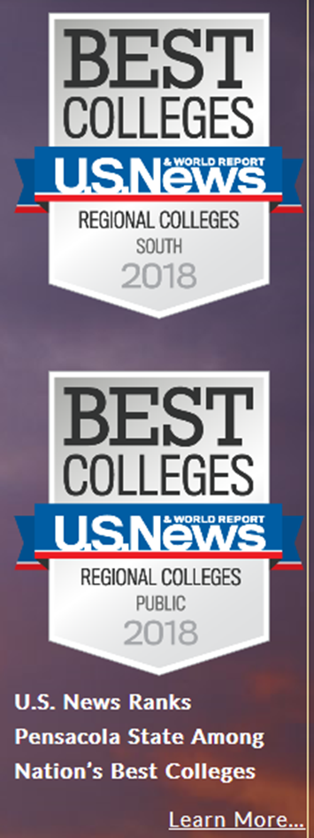
Why PSC?
Quality education at ½ the cost of a university
Pensacola State tied for 4th in Top Public Schools ─ Regional Colleges ─ South and is the highest ranked college in Florida.
PSC also ranked No. 28 in overall Best Regional Colleges South.
Among national colleges and universities, Pensacola State ranked No. 11 in Best Schools for Veterans
Nationally, we are No. 147 in Best Undergraduate Engineering Programs (no doctorate).

Slide 45
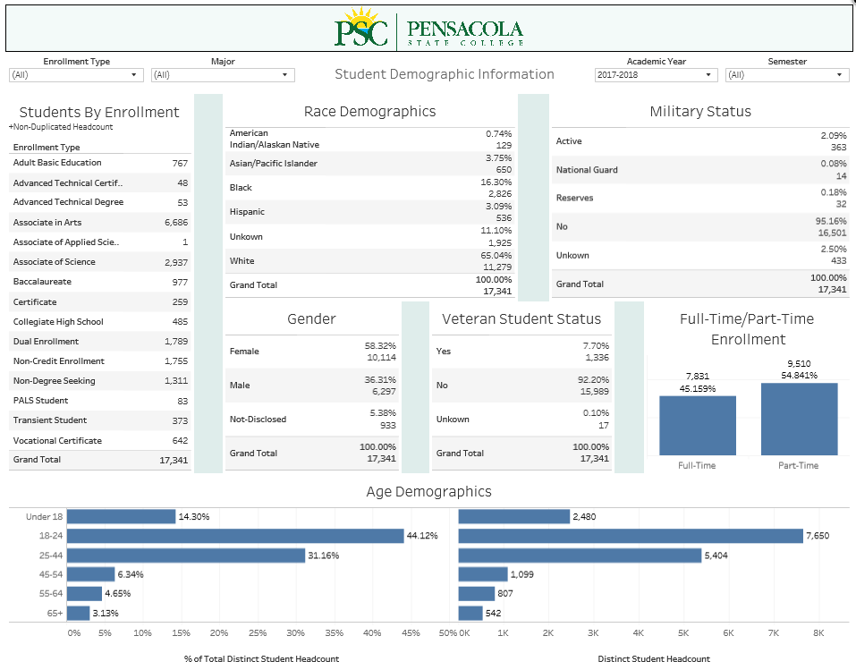
PSC SNAPSHOT

Slide 46
PSC Foundation Values
Exceptional Stewardship: Ever stronger relationships stewarded with attentive investment, measurement and communication that instills trust in our objectivity, transparency and consistency.
Collaboration: Purposeful relationships fostered between the college and a community cooperating to achieve shared or overlapping objectives that create maximum benefit for all.
Community Focused: Active and meaningful learning and sharing is pursued to enhance knowledge, skills and behaviors that promote optimum opportunity.
GRIT: Passion and perseverance motivate us to get results in time through a dedicated pursuit and achievement of goals that consistently do more… better than expected.
Commitment to Caring: We utilize integrity founded in a resilient sense of moral responsibility and competence to exceed expectations and maintain excellence.

Slide 47
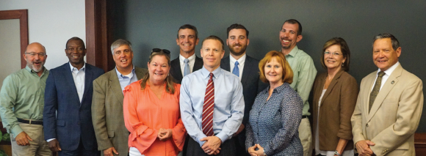
PSC FOUNDATION
BOARD OF GOVERNORS
Officers:
Mike Wiggins, Board Past-President
Doug Bates, Board President
Beverly Zimmern, Board Secretary
Tom Owens, Board Treasurer
Executive Committee Members:
Herb Woll, PSC College Trustee-Ex-Officio
Jenn Cole, Director
Gerry Goldstein, Director
Betty Roberts, Director
Committee Chairs:
Keith Hoskins-capital campaign
Alan Nickelsen-bylaws
Kerry Anne Schultz-fundraising events
Trey Poirier-nominating
Governors At Large:
Pam Caddell
Lane Harper
Karen Hendrix
Sharon Hess Herrick
Governors Emeriti
George Bailey
H. Miller Caldwell, Jr.
Carol Carlan
Bo Carter
Carolyn David
Jim Hill
Donnie McMahon
Margie Moore
Eric Nickelsen
Wayne Peacock
Marty Stanovich
James Stolhanske
Tommy Tait
Tom Lampone
Kramer Litvak
Scott Luth
Lumon May
Mike Morette
James Reeves
Grover Robinson, IV
Sandy Sansing
Julie Sheppard
Bill Wein
Celeste Whisenant
Ken Woolf
Ann Woll

Slide 48
Finance Committee Members
Tom Owens, Chair
Doug Bates, Board President
Mike Morette
Ken Woolf
Charlie Switzer
Meets 4th Tuesday Jan - Nov

Slide 49
Bylaws Committee
Alan Nickelsen, Chair
Kerry Anne Schultz
Grover Robinson

Slide 50
Fundraising Committee
Kerry Anne Schultz, Chair
Jenn Cole, Holiday Experience
Sharon Hess Herrick, Big Break
Gerry Goldstein, Quail Hunt (Pheasant Hunt)
Mike Morette, Clay Shoot
Keith Hoskins, Capital Campaign
Doug Bates, Boosters (Pirate Experience)

Slide 51
Nominating Committee
Trey Poirier, Chair
Lane Harper
Doug Bates
Tom Owens

Slide 52
PSC FOUNDATION EMPLOYEES
Andrea Krieger Executive Director of Institutional Development
850.484.1477 | akrieger@pensacolastate.edu
Laura Hill Donor Relations Manager/Events
850.484.1564 | lhill@pensacolastate.edu
Angela Kemp Scholarship Manager
850.484.1788 | akemp@pensacolastate.edu
Gaye LaCasce Director of Development
850.484.1587 | glacasce@pensacolastate.edu
Jonathan Lanza Executive Assistant
850.484.1568 | jlanza@pensacolastate.edu
Kim Davis Research Coordinator and Database Manager
850.484.2044 | kdavis@pensacolastate.edu
Lexie Mabery Front Desk/Data Entry Specialist
850.484.1560 | amabery@pensacolastate.edu
Rosemary Ropke
Accounting Specialist
850.484.1566 | rropke@pensacolastate.edu
Stephen Whiting Director of Finance and Business Operations
850.484.1233 | swhiting@pensacolastate.edu
Layla Zandi
Donor Campaigns and Reporting Manager
850.484.1567 | lzandi@pensacolastate.edu
Dr. C. Edward Meadows
President
Andrea Krieger
Executive Director of Institutional Development
Jonathan Lanza
Executive Assistant
Gaye LaCasce
Director of Development
Laura Hill
Donor Relationship Manager/Events
Starting 01/01/19
Capital Campaign Manager
Steve Whiting
Director of Finance & Business Operations
Kim Davis
Research Coordinator/ Database Manager
Lexie Mabery
Front Desk/Data Entry Specialist
Layla Zandi
Donor Campaigns & Reporting Manager
Rosemary Ropke
Accounting Specialist
Angie Kemp
Scholarship Manager

Slide 53
Donor Center Fundraising
Prompt and personal gift acknowledgement
Confirmation that their gift is used as intended
Measurable results information

Slide 56
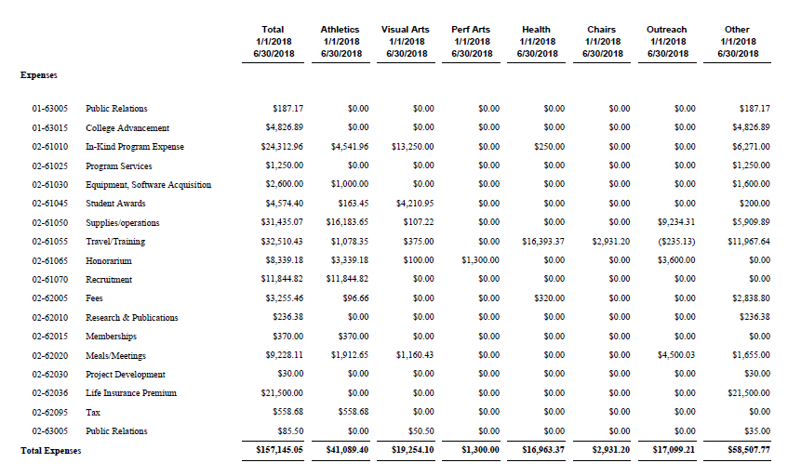

Slide 57
The Florida
Public Records Law
The Source of the Law
Article I, § 24, of the Florida Constitution states:
“Every person has the right to inspect or copy any public record made or received in connection with the official business of any public body, officer, or employee of the state, or persons acting on their behalf . . .”

Slide 58
What is a Public Record?
The statutory definition in Section 119.011(12), F.S., defines “public records” to include:
all documents, papers, letters, maps, books, tapes, photographs, films, sound recordings, data processing software, or other material, regardless of the physical form, characteristics, or means of transmission, made or received pursuant to law or ordinance or in connection with the transaction of official business by any agency.

Slide 59
“Perpetuate, Communicate or
Formalize Knowledge”
Public Records include:
Electronic Databases and Files (Rule 1B-26.003 F.A.C. specifies storage standards for electronic records)
E-Mail
Text Messages
Personal Records
But remember, all of the above must be made in connection with official college business and intended to perpetuate, communicate or formalize knowledge.

Slide 60
Location of the Public Record
The location and ownership of the equipment storing a public record are irrelevant.
Public records do not become private because they are received on your home computer using your home email address.
Conversely, your private records do not become public when received on your work computer.

Slide 61
Exemptions For State Colleges
Certain Personnel Records:
Under § 1012.81, Florida Statutes, limited-access employee records are confidential and exempt from disclosure, and include:
Student evaluations of instructors
Investigation of employee misconduct, but only while the investigation is ongoing
Disciplinary proceedings, but only until a final decision is reached
Union grievances, but only until a final decision is reached

Slide 62
Exemptions For State Colleges
Education Records:
The Family Educational Rights and Privacy Act (FERPA), 20 U.S.C. § 1232g, prohibits disclosure of student “education records.”
§ 1002.225(2), Florida Statutes, creates an exception to Chapter 119 and requires colleges and universities to comply with FERPA by maintaining the confidentiality of “education records” as they are defined by FERPA.

Slide 63
Personnel Exemptions in § 119.071
Social Security Numbers
Personally Identifiable Medical Information
Bank Account Numbers and Debit and Credit Card Numbers held by an agency
Employee information related to participation in an employee assistance program

Slide 64
Foundation Exemptions
Donor Records

Slide 65
The Family Educational Rights and Privacy Act
(“FERPA”)
FERPA grants four specific rights to eligible students:
The right to inspect and review their educational records;
The right to request the amendment of inaccurate or otherwise inappropriate educational records;
The right to approve or deny disclosure of their educational records, unless disclosure is allowed by law without their approval; and
The right to file a complaint with the U.S. Department of Education concerning any failure by PSC in complying with the requirements of FERPA.

Slide 66
FERPA
Parental Rights vs. Student Rights:
FERPA rights are held by a student’s parents until the student turns 18 or enters college, then FERPA rights are held by the student alone.
However, the parents of a student who is legally claimed as a dependent under the Internal Revenue Code are entitled access to a student’s records without the student’s consent.
But, we can’t accept a parent’s word that the student is a dependent. Parents must submit documentary proof of the dependency status to the College Registrar before any release can be approved.

Slide 67
FERPA
The main impact of FERPA for PSC employees can be summarized as follows:
Eligible students must be permitted to inspect their own educational records.
School officials may not disclose personally identifiable information about students, nor disclose their educational records to third parties, without the prior written consent of the student, unless such disclosure is permitted by an exception in the law.
Common exceptions frequently encountered at PSC are the release of directory information and releases to a school official with a legitimate educational interest.

Slide 68
FERPA
ELIGIBLE STUDENTS are those students who have applied for admission and/or who have been in attendance at Pensacola State College. This includes applicants, current attendees and anyone who has ever attended in the past.
Students who are deceased are not protected by FERPA.

Slide 69
FERPA
EDUCATIONAL RECORDS are any records maintained by the College which are directly related to a student.
Physical form or manner of storage does not matter. They can be on paper, in handwriting, email, electronic data, computer storage, video, microfiche or any other medium.
They include everything related to a student, but common items include class schedules, grades, test papers, term papers, SRS screens, computer printouts, and forms submitted by students.

Slide 70
FERPA
Questions:
The mother of an adult student lives in Alaska and has not seen her daughter for several years. Her flight to Pensacola arrived early and she wants to wait outside her daughter’s classroom with flowers and balloons to surprise her when class gets out. Can you tell the mother what room the student is in or when class gets out?
Two deputy sheriffs tell you that they have learned that a person with an arrest warrant is attending classes on campus and they urgently need to serve him with the warrant. Can you tell them what room the student is in or when the class gets out?

Slide 71
FERPA
Directory Information is defined at PSC to include:
name of student;
whether or not student is currently enrolled;
dates of registered attendance;
major field of study;
degrees earned including dates of award and major;
honors received;
participation in activities and sports;
weight and height of members of athletic teams.

Slide 72
THE YEAR AHEAD
PRIORITIES include:
70TH Anniversary Celebration
RFP Issued and Consultant Hired for Capital Campaign;
Capital Campaign Manager hired and silent phase of campaign launched;
Affinity Group Solicitation and Brochures re-launched;
Foundation Committees solidified and website integrated with PSC.

Slide 73
Capital Campaign - $35M to be tested
REQUEST FOR PROPOSAL
Background Information: Pensacola State College Foundation is a Direct Support Organization for a State College located in Pensacola, Florida.
The Pensacola State College Foundation Board of Governors is considering a capital project that is a comprehensive fundraising campaign focused in five key areas:
I. Endowments for a) scholarships b) faculty and staff development and c) program support
II. Building
III. Dormitory Replacement
IV. Establishment of a Nonprofit Center for Excellence and Philanthropy

Slide 74
Affinity Group Re-Engagement
Affinity Groups are donor groups who support areas of interest at the college. These programs are essential to college growth and program success and each has their strengths and challenges.
Affinity Group Strengths and Challenges:
FOPA – Friends of Performing Arts
Anna Society – Visual Arts Support
Boosters- Athletic Support
President’s Circle - $1500 and above/Garde Manager
Culinary & Molly McGuire Endowment
Staff and Faculty – All In

Slide 75
Affinity Groups

Slide 76
Board Engagement
Executive Council
Finance Committee
Board Structure
New:
Change in Bylaws
Board Committees
Nominating
  orientation
Fundraising
  all events
Bylaws
  annual
Capital Campaign
  Faculty and student
  Major gifts
  Grants and foundations
  Community

Slide 77
Finance and Business Operations
Stephen Whiting, Director of Finance and Business Operations
    -Angie Kemp, Scholarship Manager
    -Rosemary Ropke, Accounting Specialist

Slide 78
Finance and Business Operations
Committee Review
  Finance Committee
    Members
      Tom Owens, Chair
      Doug Bates, Board President
      Mike Morette
      Ken Woolfe
      Charlie Switzer
    Meets 4th Tuesday Jan - Nov
    Responsible for all things Financial for the Foundation including, but not limited to:
      Audit
      Budget Recommendation
      Gift Acceptance

Slide 79
Finance
  Function
    All business processes and financial matters
    Areas of Responsibility
      Donations/Revenue (including Endowment Allocations) – Rosemary
      Program and Operating Expenditures – Rosemary
      Scholarship Management & Expenditures – Angie
      Reconciliation, Reporting, Compliance, Finance Committee Liaison, Annual Audit - Steve
Business Operations
  Policies and Procedures (WIP)
    We are College employees and are required to know and abide by College policies and procedures
      INTRANET home: http://piratenet.pensacolastate.edu/
      Policy Manual: http://piratenet.pensacolastate.edu/docs/policies/2017/Board-Policies-Manual-March-2017.pdf
      Procedure Manual: http://piratenet.pensacolastate.edu/docs/policies/2017/Manual-of-Procedures-2017.pdf
      Forms are here (TRAVEL): http://piratenet.pensacolastate.edu/forms/
    Foundation specific policies & procedures (WIP):
      Found here: H:\Shared\PSCFoundation\Policies & Procedures
      Gift Acceptance Policy
      Gift Return Policy
    IT HELP DESK Ext 1702 http://www.pensacolastate.edu/helpdesk/
      Payroll Online, Email Online, Office 365 Subscription FREE

Slide 80
Business Operations (cont.)
  Leased Properties
    Athletic Dorms
      oversight/maintenance and upkeep
      Two resident coaches, a men’s and women’s coach
    Metzger Triplex & Duplex
      Managed by Etheridge Property Management
      Net Income can only be used for Universal Scholarships
      Rented to General Public
  Finance “Daily” Process (after successful solicitation and ongoing Dev!)
    Data entry agent, with another, opens mail and restrictively endorses checks
    Data entry agent inputs receipts in QB Online & scans source docs to shared network drive
      A&M (Annual & Memberships: FOPA, Athletic Boosters, Anna Society, Alumni Affairs) - Layla
      Events (Quail Hunt, Big Break, Clay Shoot, Holiday Experience) - Laura
      Campaigns (Switzer Center – Limitless, program support, new scholarships/endowments) - Gaye
      Scholarships (Endowment Additions, Annual Scholarship Donations) - Angie
      Misc (Rent, College Reimbursements, Loans) - Rosemary
    Each Area of Responsibility will update RE
      Enter/Update Constituent
      Enter Gift/Pledge
      Acknowledge Gift
      Send Pledge Reminders

Slide 81
Athletics
  House 50 athletes
    Baseball
    Basketball – Men’s & Women’s
    Softball
    Volleyball
  Support
    Coaching Staff
    Recruiting
    Equipment
  Manage
  Income Restricted
    Sustaining Property
    Universal Scholarship Support
Metzger Housing

Slide 82
Scholarships – Scholarship Manager
  249 Available
  Managed by Criteria – Guidelines created by the donor which cannot be changed without written donor consent.
  Awarding Process
    Application Deadlines–each semester
    Awarding Period –applications reviewed, ranked, & awarded by committee
    Recipient Notification – recipients are notified of scholarship award(s) by PirateMail and must accept or decline each scholarship award
    Accepted Awards- are applied to recipients’ account
    Unused Funds- returned to the originating scholarship account(s)

Slide 83
  NextGen Scholarship Manager – Online scholarship software implemented through a collaboration between the Foundation and Pensacola State College for applying, reviewing, and awarding all college scholarships.
    Streamlined scholarship application process with 24/7 access – students apply for multiple scholarships using a single, customized application. (Helps ensure funds are not over-awarded or unused.)
      Foundation Office manages donor funded scholarships and state grants
      Financial Aid Office manages college funded scholarships and federal grants

Slide 84
  Committees
    Scholarships committee assignments are based on criteria.
    Committee members – Department Heads, Directors
    Committee Chairs – Deans
    Foundation Committees:
      General Scholarship Committee
      Grants
      Health Sciences
      Humanities
      Milton
      Natural Sciences and Business
      Non Degree Specific
      Universal
      Universal – Scholastic Achievement
      Workforce Education and Vocational

Slide 85
Erin | Spicer | VP, Academic & Student Affairs
Sarah | Lewis | Administrative Support Specialist, VP of Academic & Student Affairs
Debbie | Douma | Dean, Grants & Federal Programs
Staci | McKerren | Senior Executive Assistant, VP of Administrative Services & General Council
Rebecca | Causey | Director, Educational Opportunity Center
Monique | Collins | Asst. Dean, Student Services, Advising & Career Services
Rob | Gregg | Director, Veterans Upward Bound
Deborah | Hooks | Director, Career & Technical Education/Student Job Services
Sandy | Moore | Department Head, Allied Health
Dusti | Sluder | Dean, Warrington Campus
Lisa | Payne | Executive Assistant, Dean (Warrington)
Lori | Wichman | Director, Nursing & Emergency Medical Services
Brenda | Kelly | Dean, General Studies
Krist | Lien | Department Head, Visual Arts
Susan | Morgan | Department Head, History/Languages/Social Sciences
Tracy | Peyton | Department Head, English/Communications
Don | Snowden | Department Head, Performing Arts
Anthea | Amos | Dean, Milton Campus
Kirk | Bradley | Dean, Baccalaureate Studies & Academic Support
Michael | Allen | Department Head, Biological Sciences
Hikmat | BC | Department Head, Physical Sciences
Kathy | Dutremble | Dean, Student Services
Tonie | Anderson | Counselor, Student Services (Milton)
Rachelle | Burns | Director, Student Support Services, TRIO
Karen | McCabe | Dean, South Santa Rosa Center
Karen | Todd | Senior Administrative Assistant, Student Services
Dan | Busse | Dean, Workforce Education & Vocational Support
It takes a village

Slide 86
Types of Scholarships
  Endowments
    Minimum gift - $20,000 for a named endowment
    Gift is invested (Foundation Board – Finance Committee Policy)
    Gift corpus is never invaded
    Interest earned (3-year rolling average) is designated to a separate account each year to fund scholarships
  Other
    One time gifts and gifts less than $5,000
    Funds deposited into Universal Scholarship Fund
    Donor may still designate gift

Slide 87
Top Ten Scholarships – Endowments (174 Total)
  Chadbourne Foundation Endowed Scholarship
  Alfred I. duPont Foundation Endowed Scholarship
  Marjan Mazza Business and Management Endowed Scholarship
  Molly McGuire Culinary Arts Endowed Scholarship
  General Scholarship Endowment - Universal
  Robert H. Kahn Endowed Scholarship
  Ami-Lee Wilder Memorial Scholarship Endowment
  McDonald’s Hospitality Endowed Scholarship
  Rufus A. Whitmire Endowed Scholarship
  Rotary Club of Pensacola Endowed Scholarship
Top Five Scholarships – Annual
  Universal Scholarship Fund
  South Baldwin County Health Foundation’s Allied Health Scholarship
  Theresa Gail May Scholarship
  Sansing Scholars
  Dr. Douglas C. Morris Nursing Scholarship

Slide 88
Donor Relations
  Recipients are required to write thank you notes for awards received.
  Questions and requests by donors.
  Scholarships that require additional action.
  FERPA
  New Scholarships and Endowments
Reporting
  Thank you notes are sent to donors/contacts after each semester.
  An Annual Scholarship Report is sent after the Summer semester (end of academic year) with Summer thank you notes and – in some cases – a Financial Report.
  State Grants – require annual reporting and private matching funds
    Florida Blue
    First Generation

Slide 89
Community Presentations
  Provide scholarship information for scholarship presentations
    History
    Awarding
    Balances
Scheduling Students to Share Impact
  Several civic and other organizations request each year’s scholarship recipients to attend one of their meetings. Scholarship recipients are asked and encouraged to attend.
  Civic and other organizations may request recipient attendance for an upcoming meeting.
  Special scholarship lunches with donor and recipients.

Slide 90

More than $623,000
in Foundation scholarships awarded to students in 2017

Slide 91
In-kind Donations – gifts of goods or services
  Value (fair market value) of the donation is determined by the donor.
  Gifts over $5,000 must have a qualified appraisal.
    Consumable In-kind Donations – expendable items
      In-kind forms received are entered into RE.
      Most are event related.
    Non Consumable In-kind Donations – inventory items
      Donor completes and signs In-Kind form. Form must also have department signature.
      A memo to Dr. Meadows is prepared and processed.
      When memo is returned it is entered into RE.
      Usually generated within college departments.

Slide 92
Director of Development
Major Gifts
  Campaigns
    Limitless/Visual Arts
  Naming Opportunities
  Key Donors/Partners
President’s Circle
  Members
  Roles
  Value and Tracking
Building Construction
  Building One (and) other opportunities
  Role of State in replacement
  Role of Community
Donor Development
  Outreach and Protocols for responses to Donors
  Raisers Edge Roles and Responsibilities
Front Desk and Database Manager
  Responsibilities and Protocols
  IN-Kind
  Data Entry
Donor, College and Community Engagement
  Website
  Community presentations
  Interviews
  Social Media

Slide 93
Naming Opportunities
Significant gifts to the college will provide opportunities for donors to designate the name of a college facility or program in honor of the donor or another person. Scholarships, endowed chairs, lecture series, and faculty and staff awards programs are among the named gift opportunities, as are buildings or portions of buildings, including laboratories and conference rooms. Named gift opportunities range from $10,000 to $5,000,000.
Significant gifts to the college provide opportunities for donors to designate the name of a college facility or program in honor of the donor or another person. Scholarships, endowed chairs, lecture series, and faculty and staff awards programs are among the named gift opportunities, as are buildings or portions of buildings, including laboratories and conference rooms. Naming opportunities range from $10,000 to $5,000,000 and are offered in recognition of a single, tax-deductible, irrevocable gift or written pledge made over a specified period of time. Related matching funds are considered as additional to the original gift to the College. The following is a comprehensive list representing the minimum contribution required for specific naming opportunities as approved by the College Board of Trustees. College Campuses
Pensacola Campus $ 5,000,000
Warrington Campus $ 4,000,000
Milton Campus $ 3,000,000
South Santa Rosa Center $ 3,000,000
Century Center $ 1,000,000
Downtown Center $ 1,000,000

Slide 94
Affinity Group Management
President’s Circle
Members of the President’s Circle are special people…
The President’s Circle is open to any person wishing to contribute a minimum of $1,000 annually and can be split among their choice of: the Fund for Excellence, allowing us to respond to opportunity and needs as they present themselves, Athletics, Visual Arts-Anna Society, Performing Arts-Friends of Performing Arts, WSRE, and the Alumni Association ($250). Pledges can be billed monthly, quarterly or annually. We ask donors to let us know if your business is a Matching Gift company, as your gift may be doubled or more.

Slide 95
Front Desk and Database Manager
Phones
  Message for Closings and Staff Director
  Recording alternate messages
Data Entry
  Raisers Edge
  Emergency Contact List Updates
  Other Data Entry
Mailings
  Raisers Edge Mail Merge
  Receive and Distribute Mail
  Bulk Mailings
  Donor Appeals
Event Assistant
  RSVPs
  Creating Labels and Nametags
  Goodie Bags
  Donor Calls/solicitations
Meeting Assistance
  Board and Committee Call backs
  Limited Surveying

Slide 96
Donor Campaigns/Reporting Manager
Annual Fund
  What is it?
  Who is asked
  Renewal and outreach
  Donor rewards and thank you response protocols
Boosters
  What is it?
  Who is asked
  Renewal and outreach
  Donor rewards and thank you response protocols
Anna Society
  What is it?
  Who is asked
  Renewal and outreach
  Donor rewards and thank you response protocols
FOPA- Friends of Performing Arts
  What is it?
  Who is asked
  Renewal and outreach
  Donor rewards and thank you response protocols
FOCA- Friends of Culinary Arts
  What is it?
  Who is asked
  Renewal and outreach
  Donor rewards and thank you response protocols

Slide 97
Affinity Groups

Slide 98
Events Manager
Laura Hill
Big Break
Day of Clays
Holiday Experience
Pheasant/Quail Hunt- Alumni Association
Quail Hunt
Garde Manger
70th Anniversary
Ribbon Cuttings/Naming Ceremonies/College Events

Slide 99


Pheasant/Quail Hunt- Alumni Association (by invitation) October
Quail Hunt (by invitation) February of each year
Garde Manger (by invitation) donor appreciation event
70th Anniversary– 09/13/18

Slide 100

Providing
workforce-ready
graduates
for local business needs

Slide 101

PSC Governors
ARE
Passionate Supporters

Slide 102
Welcome Aboard
We hope you are excited by your participation on this special team!
Andrea Krieger
Executive Director of Institutional Development
Cell: 850-232-2244
Direct Office Line: 850-484-1477
akrieger@pensacolastate.edu

